Slide 1
GCSE Design & Technology

Slide 2
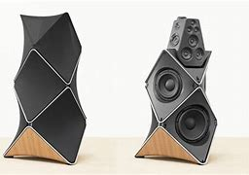
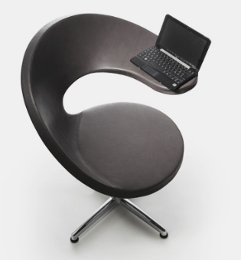
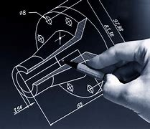
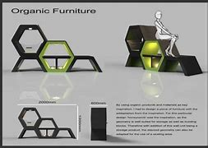
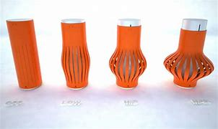
Why choose GCSE D&T?

Slide 3
Transferable skills gained by studying Design & Technology
Using initiative: adapting to changing circumstances, becoming more self motivated, working through problems and solving them
Being organised: managing own time, review and revise own schedule
Good communication: explain and present idea clearly and effectively, using appropriate verbal, written and graphical methods of communication, listening and responding to others views
Being innovative: challenge existing ideas, solve problems to make people’s lives better
Good teamwork: value the skills of others, value diversity and difference, understand how to work with others
Being analytical: Embrace new knowledge, process information, apply experiences from other subject areas

Slide 4
Creative industries contributed to £115.9 gross value added to the UK economy

Slide 5
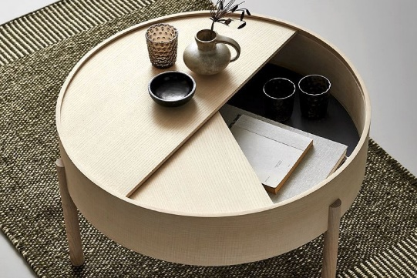
Specification Overview
Component 1 - 50% of Qualification
Externally assessed exam
Based on:
technical principles
designing and making principles
along with their ability to:
analyse and evaluate design decisions and wider issues in design and technology.
Component 2 - 50% of Qualification:
Internally marked externally moderated
A sustained design and make task, based on a contextual challenge set by WJEC, assessing candidates' ability to:
identify, investigate and outline design possibilities
design and make prototypes
analyse and evaluate design decisions and wider issues in design and technology.

Slide 6
Specification Overview Component 1 (50%):
Core knowledge and understanding - five clear and distinct topic areas:
design and technology and our world
smart materials
electronic systems and programmable components
mechanical components and devices
materials
Learners need to:
study all of the content in these five areas with a broad knowledge and understanding of design and technology
be able to apply this knowledge in design and make activities.
PLUS In-depth knowledge and understanding in :
natural and manufactured timber

Slide 7
Specification Overview Component 2: Designing and making principles for NEA (50%):
In-depth knowledge and understanding is presented in five clear topic areas:
• selecting and working with materials and components
• marking out
• using tools and equipment
• using specialist techniques
• using surface treatments and finishes

Slide 8
NEA – Non Examined Assessment – 50% of the qualification: Design & make task
NEA Portfolio of evidence:
A final design brief developed by the learner following a thorough analysis/research into a range of problems that have arisen from a contextual challenge
A design portfolio including informal sketchbook that includes evidence of a personal iterative design journey
A final high quality prototype (or prototypes) based on the design brief
Additional evidence (tests pieces, trials, mock-ups, toiles) to support the iterative process

Slide 9
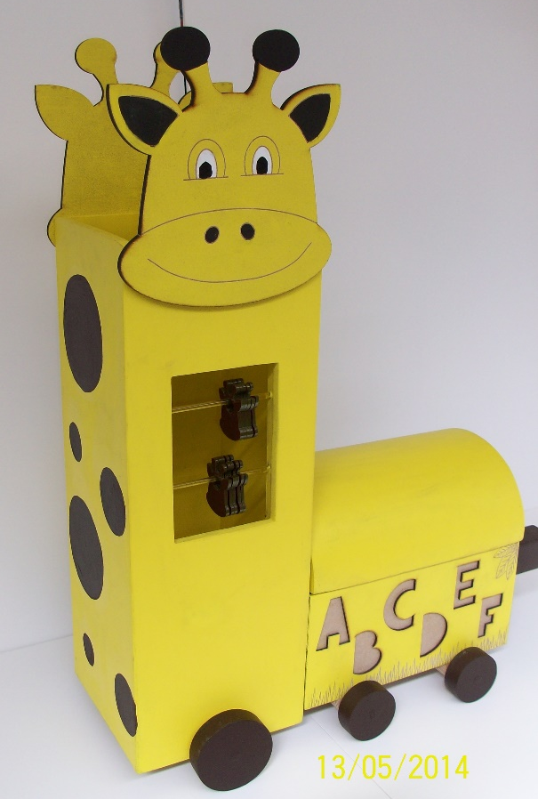
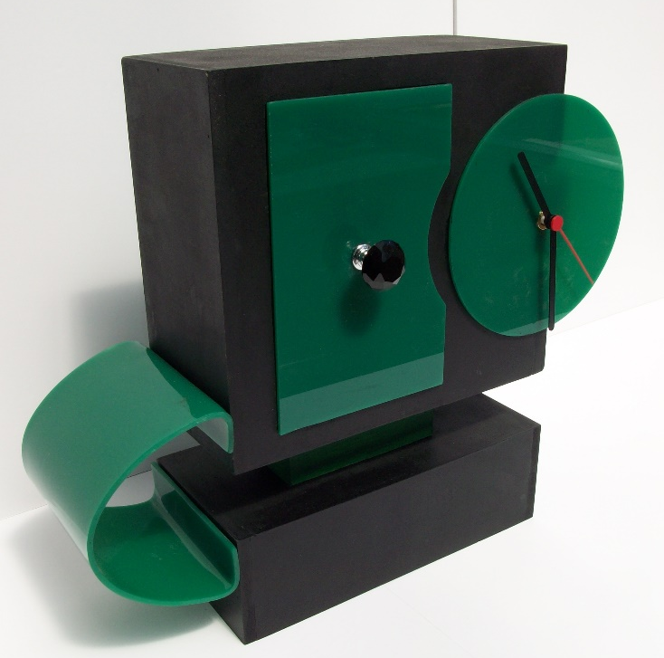
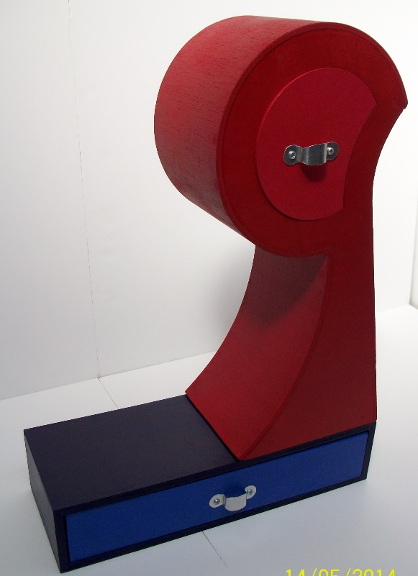
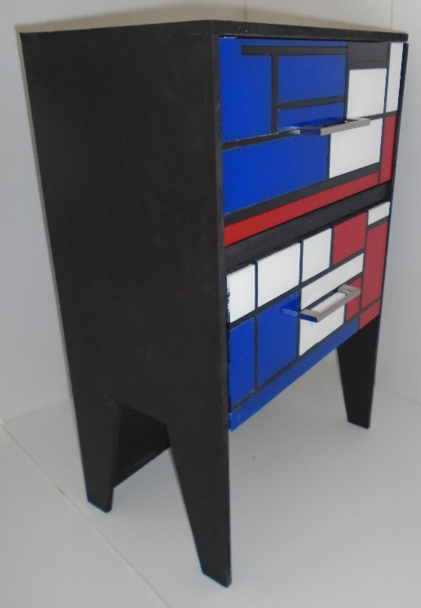
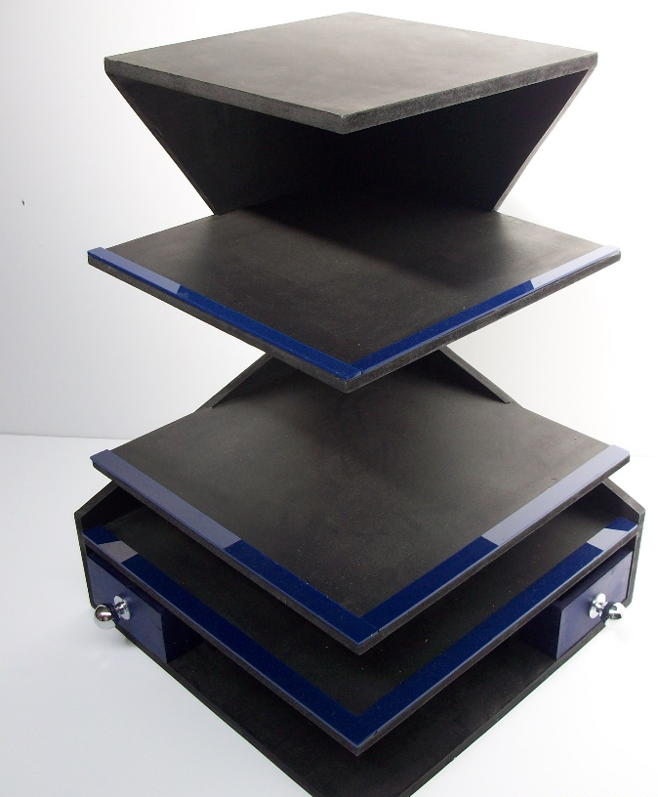
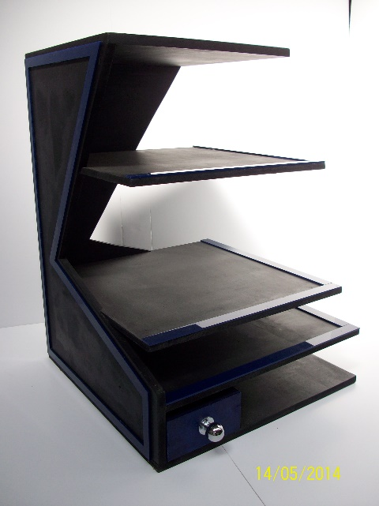
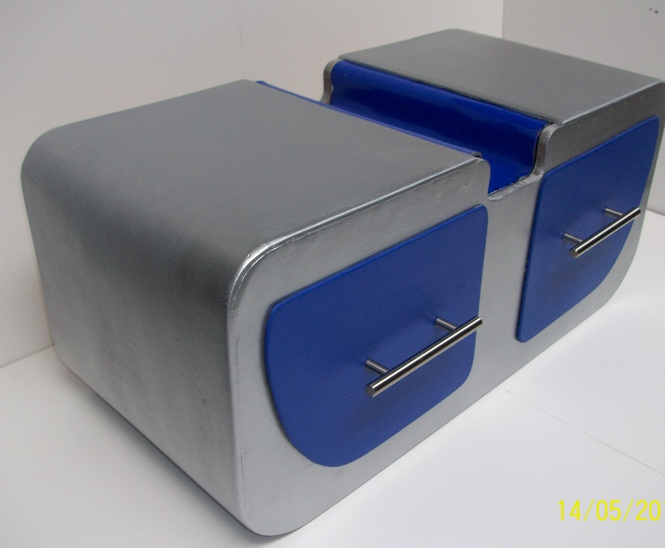
Pupils GCSE work at Hall Green School

Slide 10
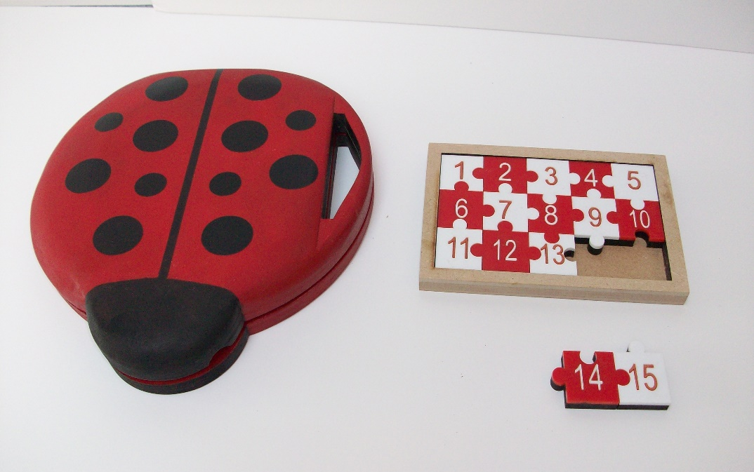
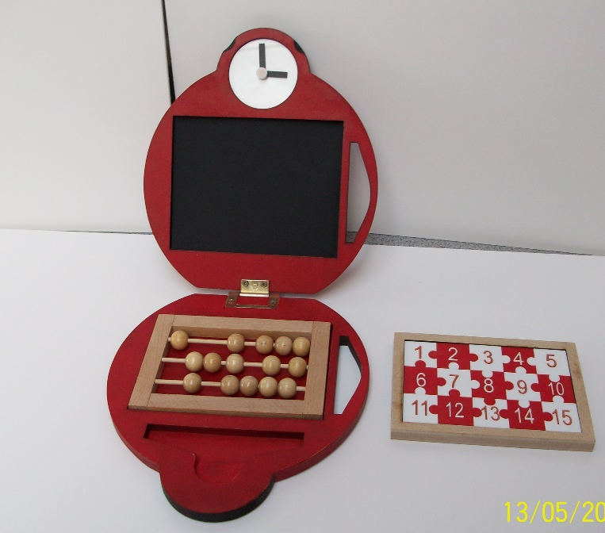
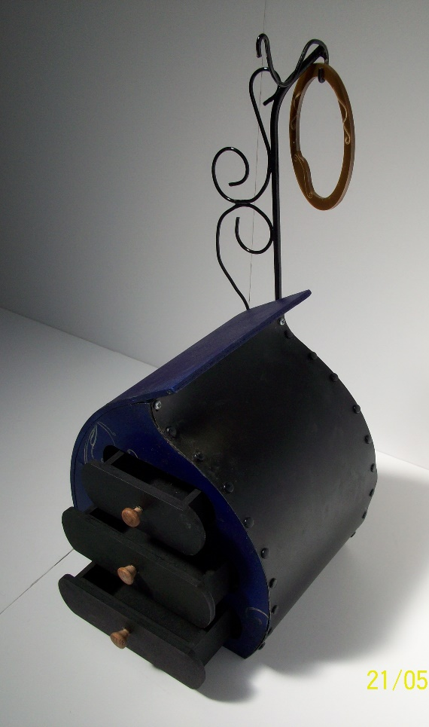
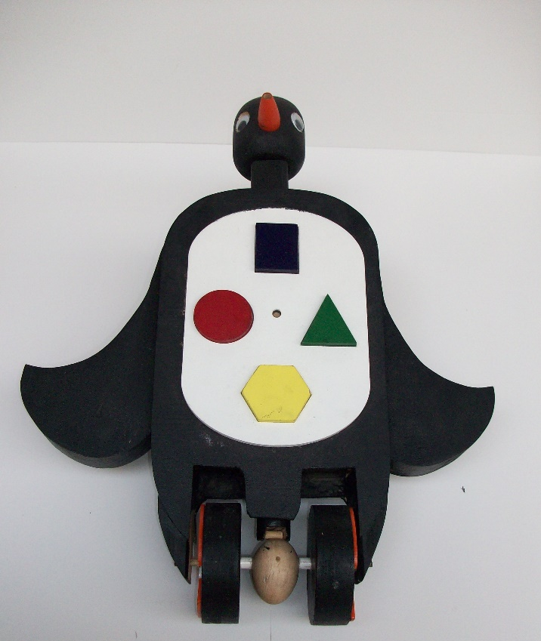
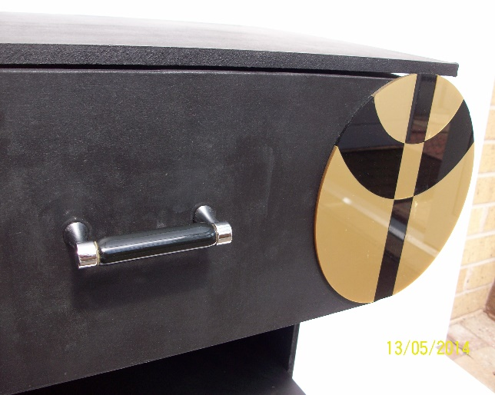
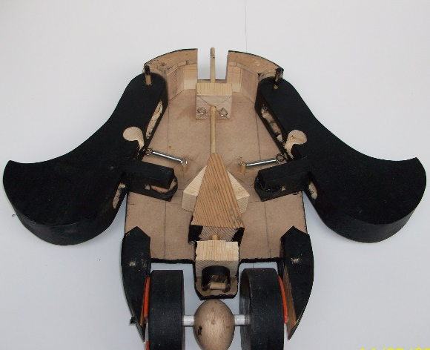
Pupils GCSE work at
Hall Green School

Slide 11
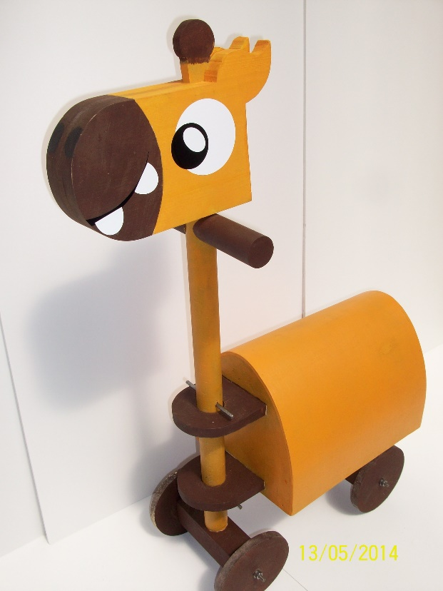
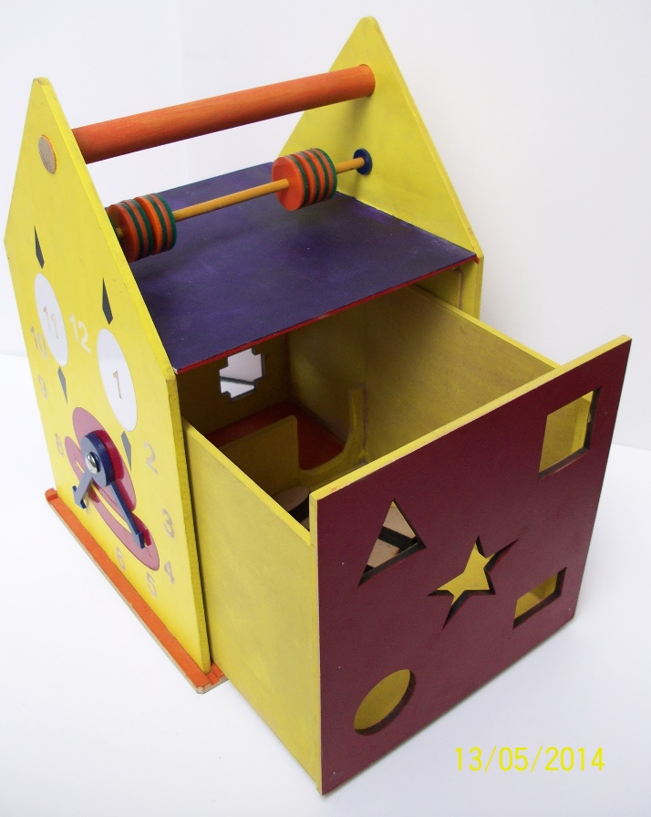
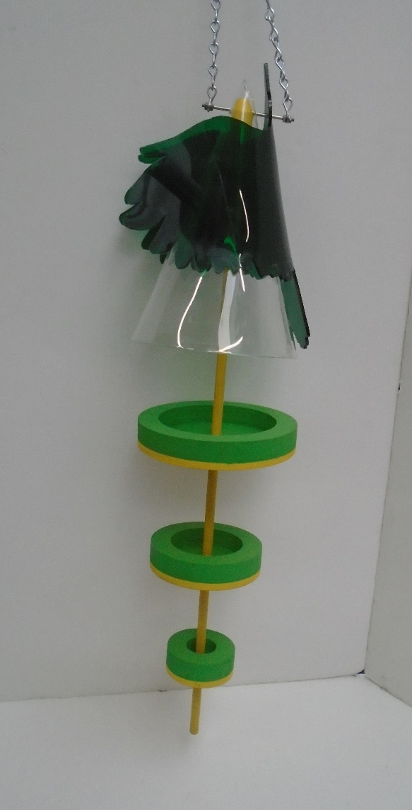
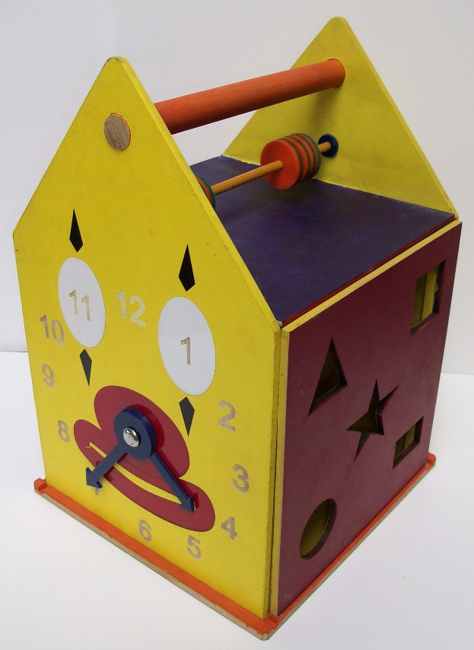
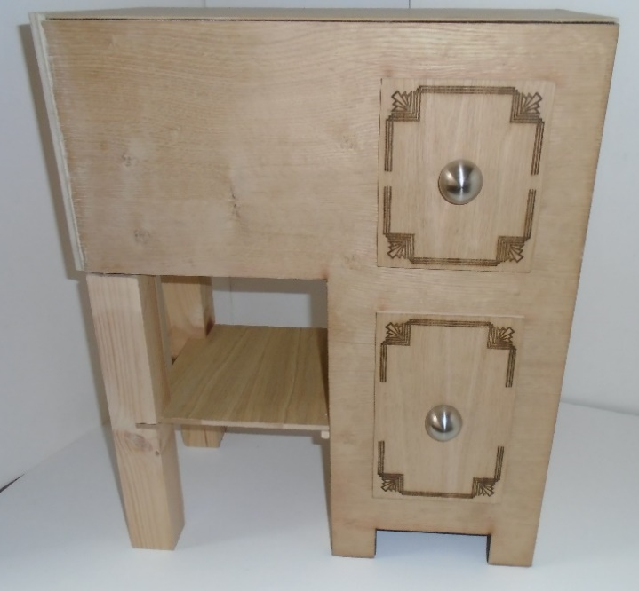
Pupils GCSE
work at
Hall Green
School

Slide 12
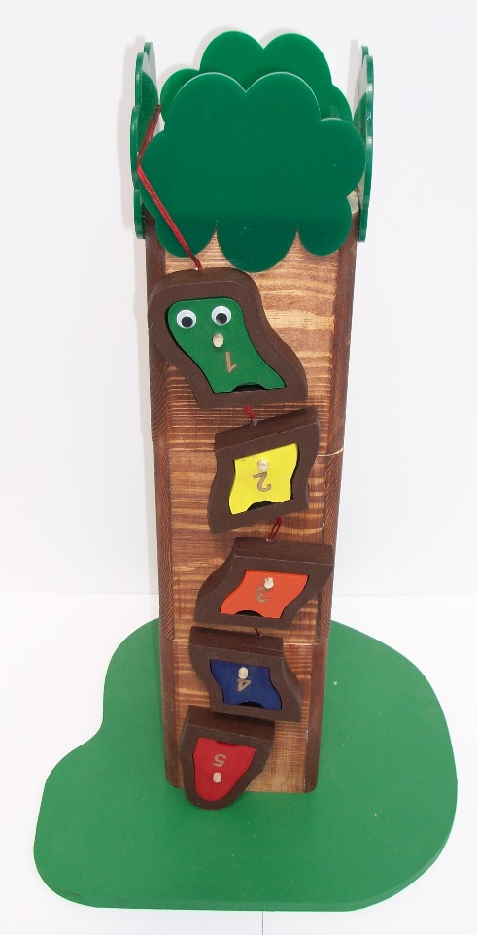
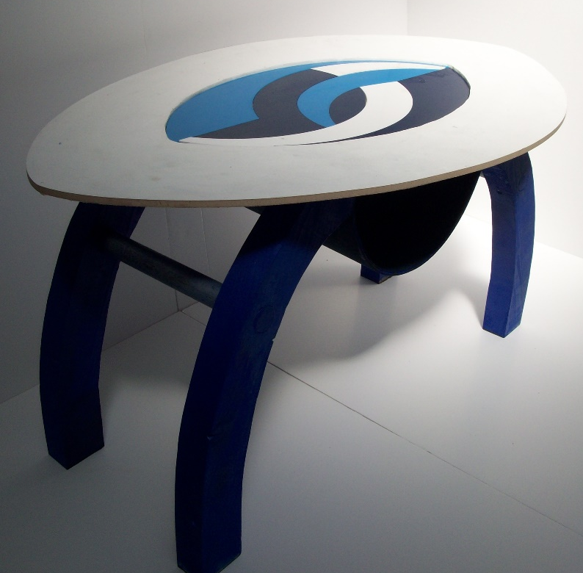
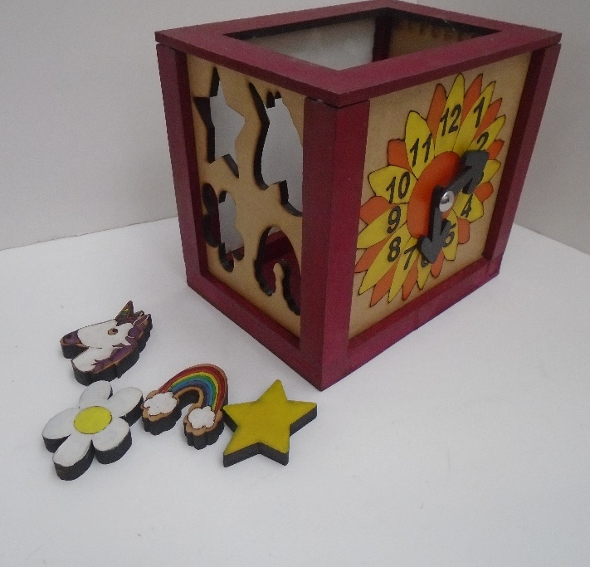
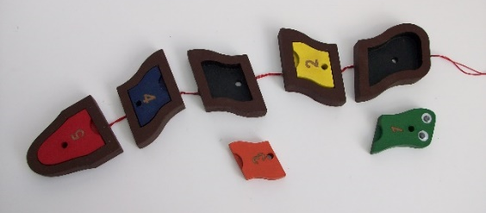
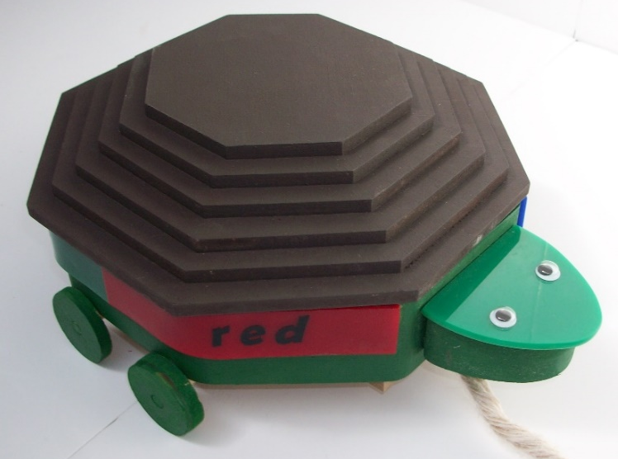
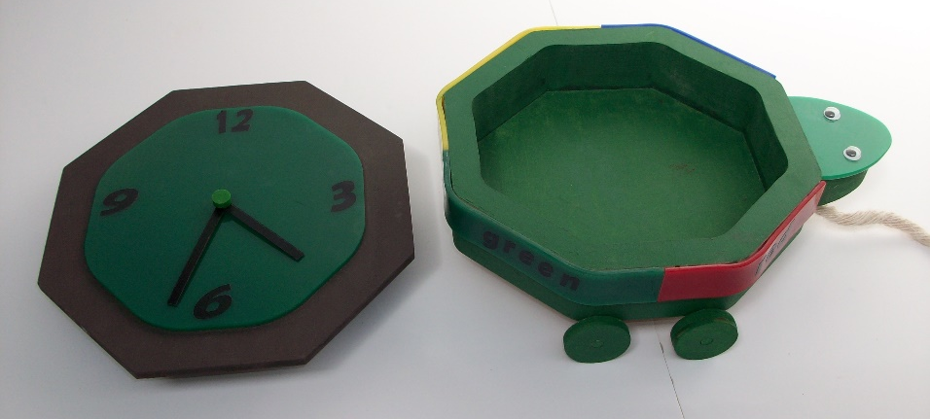
Pupils GCSE work at
Hall Green School

