Slide 1
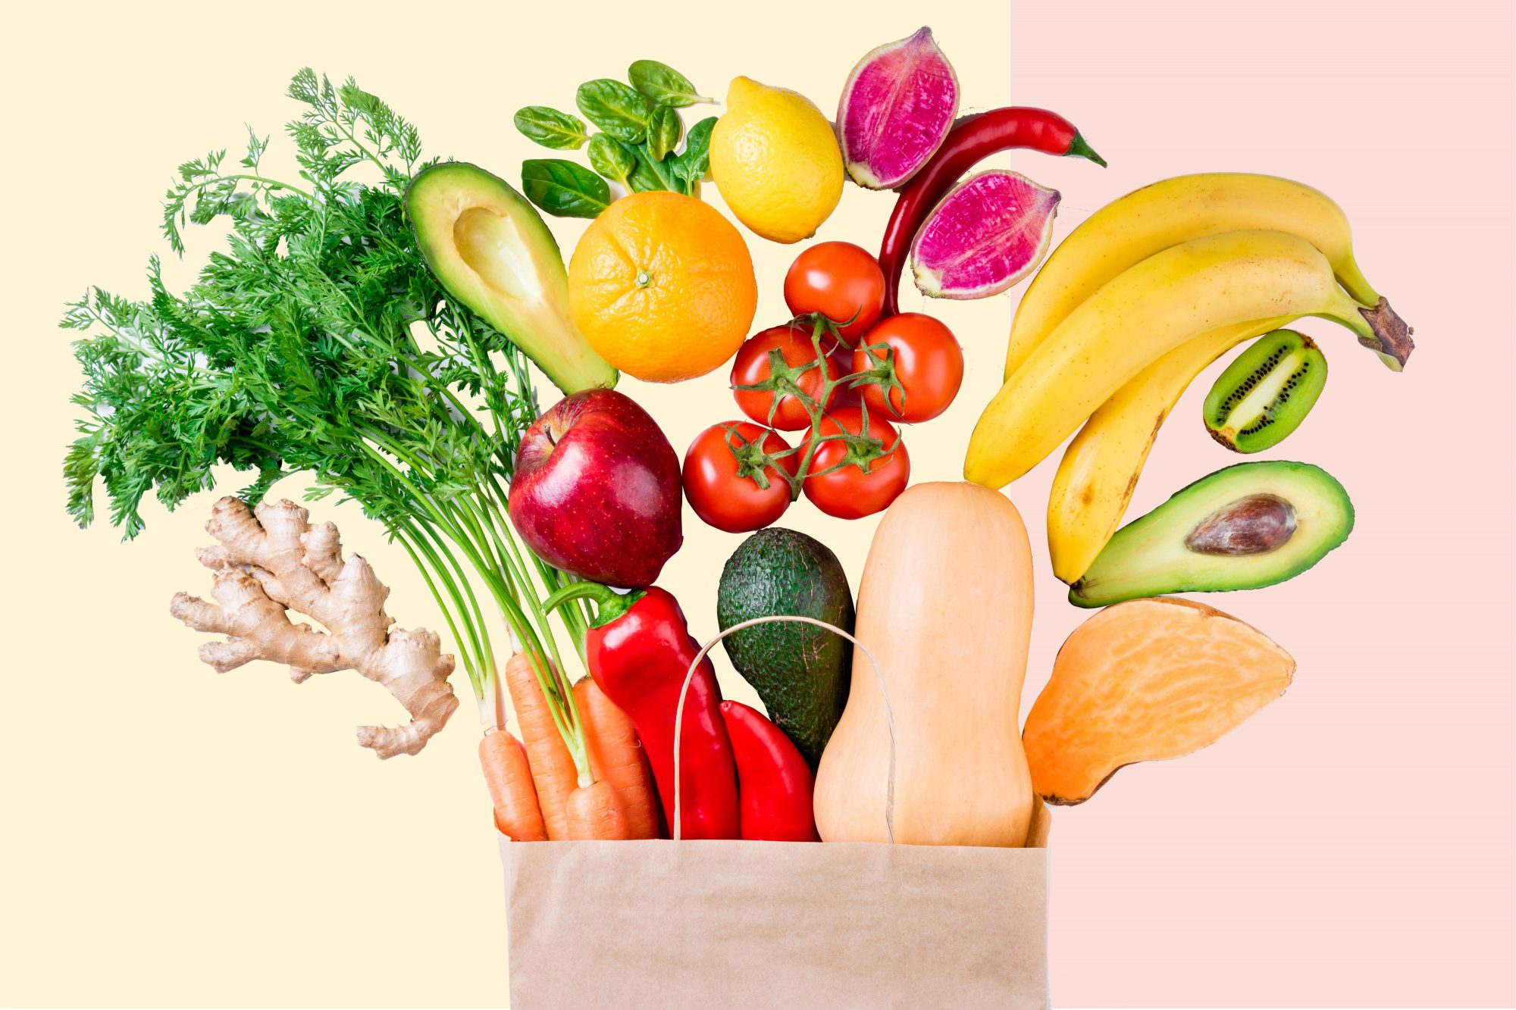
GCSE
Food Preparation and Nutrition

Slide 2
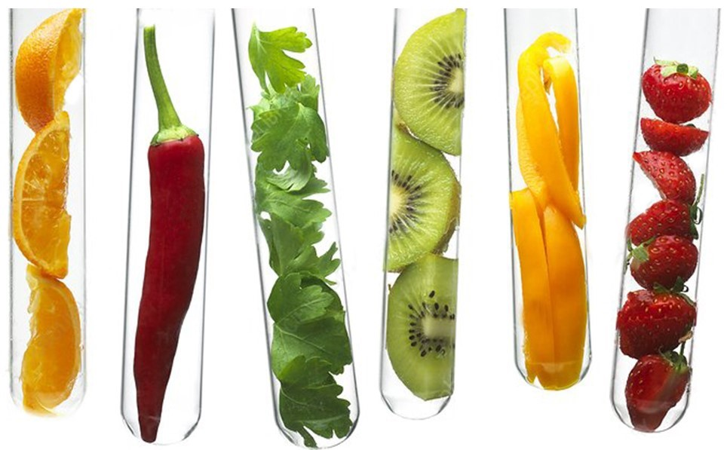
GCSE Food Preparation and Nutrition is a practical based - hands on course which focuses on nurturing your practical cookery skills to give you a strong understanding of nutrition and food science.

Slide 3
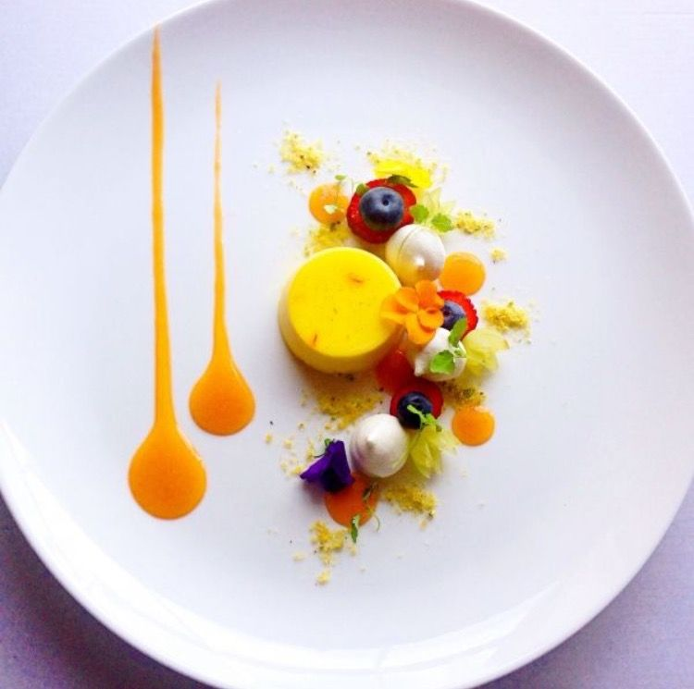
What will you learn?
GCSE Food Preparation and Nutrition will help you to develop a greater understanding of nutrition, food provenance and the working characteristics of food materials. You’ll also learn about food from around the world, through the study of British and international culinary traditions as well as developing an understanding of where food comes from and the challenges surrounding food security. You’ll master culinary skills and appreciate the science behind food and cooking.

Slide 4
Practical Skills
Throughout the course you will develop a range of practical skills.
The twelve main skill areas are listed below:
General practical skills including: weighing, measuring, preparing ingredients and equipment, correct cooking times, testing for readiness and sensory testing.
Using the cooker including: the hob, grill and oven.
Techniques to prepare, cook and combine different ingredients.
Making dough including: bread, pastry and pasta.
Use of equipment including: blenders, food processors, mixers, pasta machines and microwave ovens.
Use of raising agents including: eggs, chemical, steam and biological.
Sauce making including: starch based, reduction and emulsions.
Knife skills including: fruit, vegetables, meat fish or alternatives.
Setting of mixtures through use of heat and egg protein.
Cooking methods including: steaming, boiling, simmering, blanching, poaching and frying.
Tenderising and marinating different ingredients.
Preparing fruit and vegetables.

Slide 5
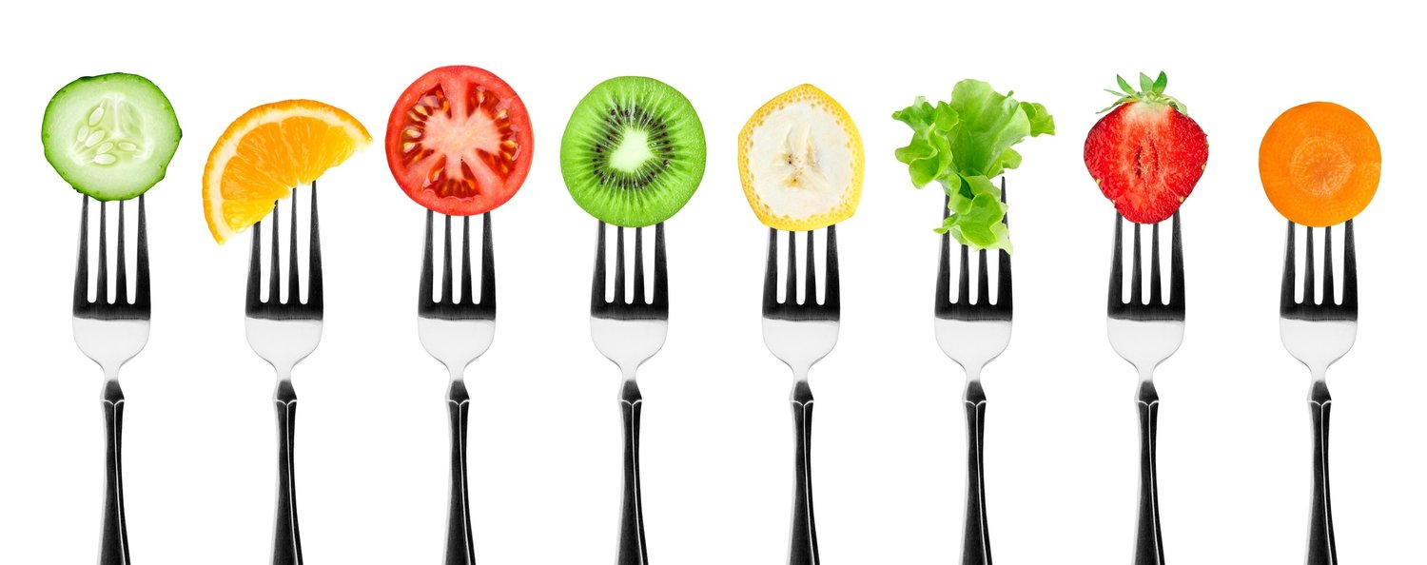

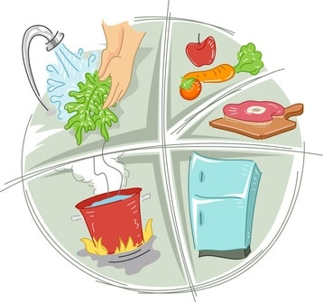
Food preparation skills are integrated into five core topics:
Diet, nutrition and health
Food Choice
Food Provenance
Food Safety
Food Science

Slide 6
Diet Nutrition and Health
Nutrient functions and sources
Effect of nutrient deficiency and excess
Energy balance
Impact of an individual’s life stage on nutritional requirements
Special dietary needs
Diet related health problems

Slide 7
Food Science
Reasons for cooking food.
Methods of cooking and heat transfer.
Functional and chemical properties of protein – denaturation, coagulation, gluten formation and foam formation.
Functional and chemical properties of carbohydrate – gelatinization, caramelization and dextrinisation.
Functional and chemical properties of fat – plasticity, shortening, aeration and emulsification.
Raising agents.

Slide 8
Food Safety
Signs and causes of food spoilage and contamination.
Use of micro-organisms in food production.
Bacterial contamination and food poisoning.
Principles of food safety when buying, storing, preparing, cooking and serving food.

Slide 9
Food Choice
Factors influencing food choice.
Food labelling and marketing.
British and international cuisines.
Sensory analysis – how we taste food and how our senses influence food choice.

Slide 10
Food Provenance
Food sources – where and how ingredients are grown, gathered, reared and caught.
Food and the environment.
Sustainability of food.
Food production.
Technological developments.

Slide 11

Written Examination
Theoretical knowledge of food preparation and nutrition from the five core topics will be assessed through a 1 hour 45 - minute written examination.
The paper has two sections:
Section A consists of 20 multiple choice questions (20 marks)
Section B consists of 5 questions (80 marks)
The written examination counts for 50% of your final grade.

Slide 12
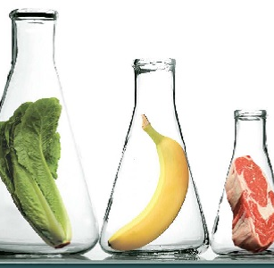
Non-Exam Assessment - Task 1
Food Investigation Task
You will carry out an investigation into the scientific principles that underpin the preparation and cooking of food. This task will provide you with an opportunity to demonstrate your knowledge and apply your understanding of the science behind cooking. You will investigate ingredients and explain how they work and why.
A report of 1500 – 2000 words will be produced.
NEA 1 counts for 15% of your final grade.

Slide 13
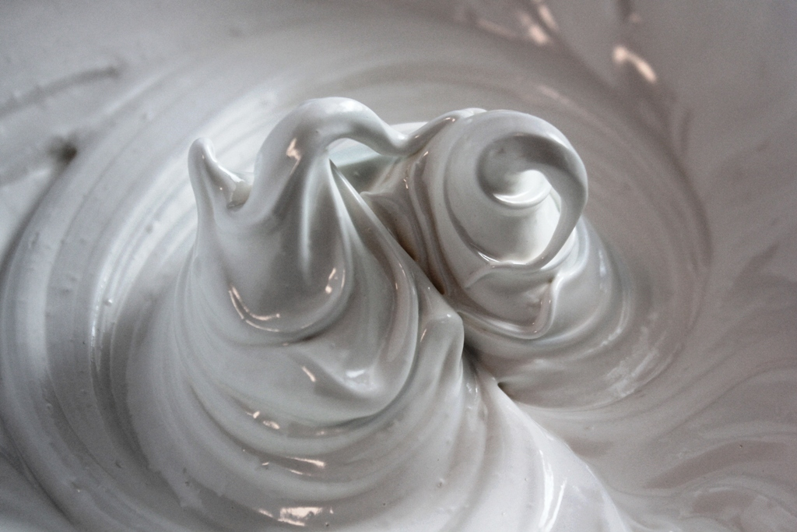

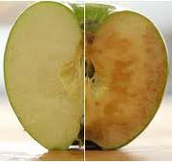
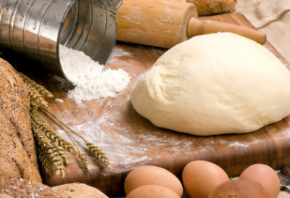
Investigate the functional and chemical properties of ingredients used when making meringues.
Investigate the use of raising agents in baked products
Investigate the causes and prevention of enzymic browning.
Investigate the functional and chemical properties of the ingredients used to make bread.

Slide 14
Non Exam Assessment - Task 2
Food Preparation Task
You will research, plan, prepare, cook and present a three- course menu. This task will provide you with an opportunity to cook up a storm and showcase your creativity and cooking skills. You might make a street food menu, create delicious tapas dishes or cook up a menu for a student on a budget. Photographs and written evidence of work showing research, recipe trials, planning, preparation, cooking and presentation of the final menu and evaluation are submitted.
NEA 2 counts for 35% of your final grade.

Slide 15
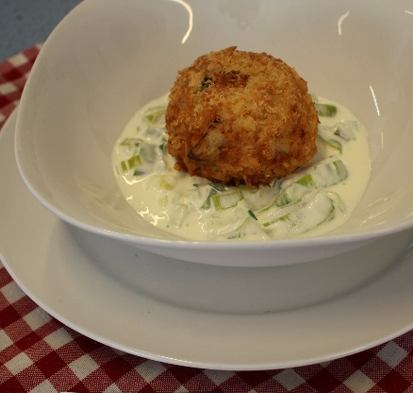
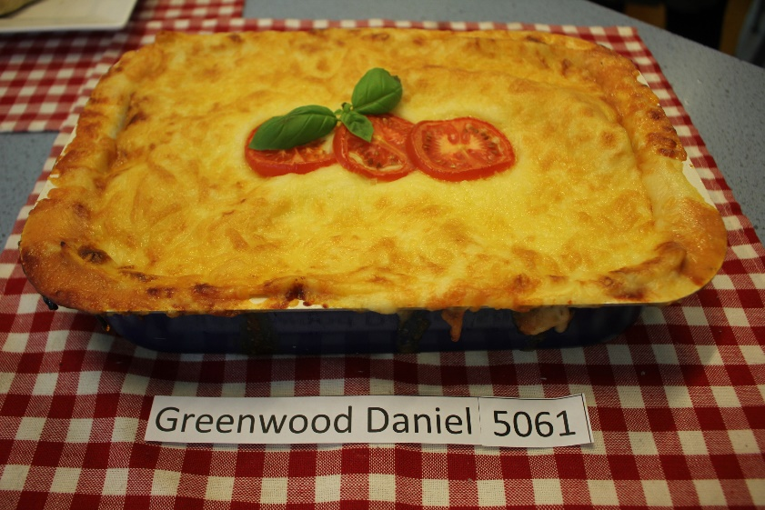
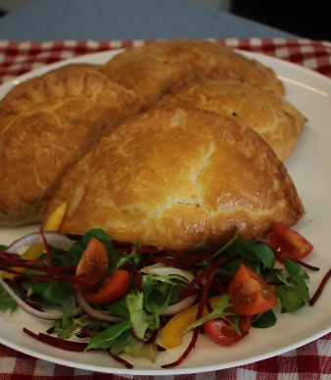
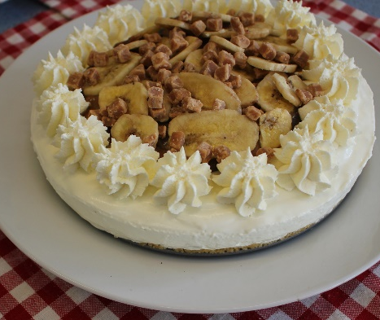
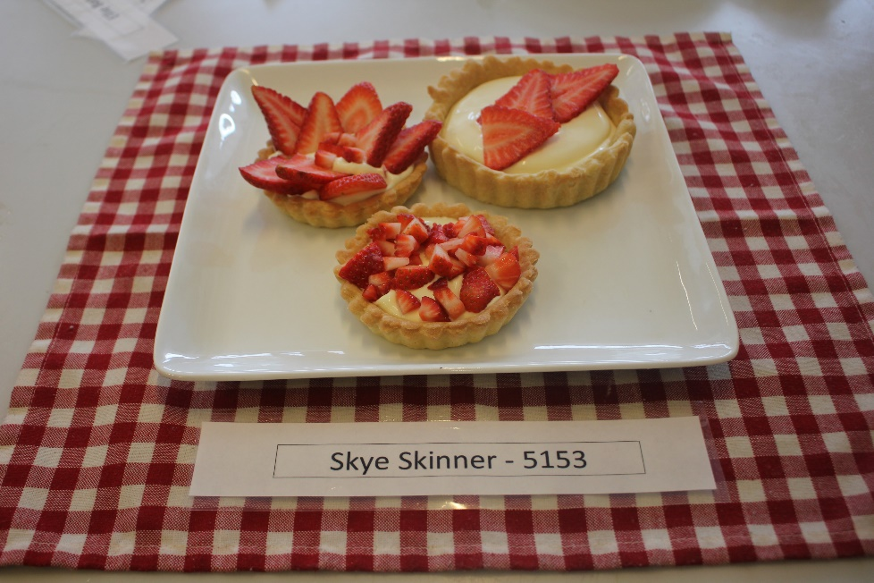
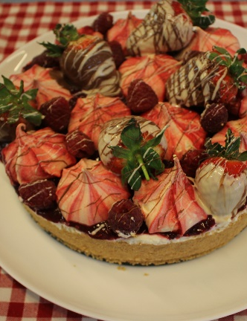
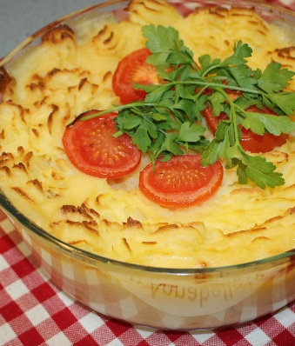
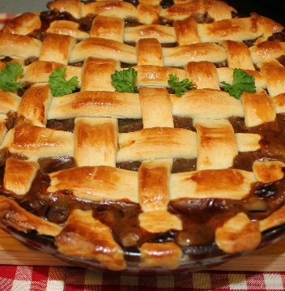

Slide 16


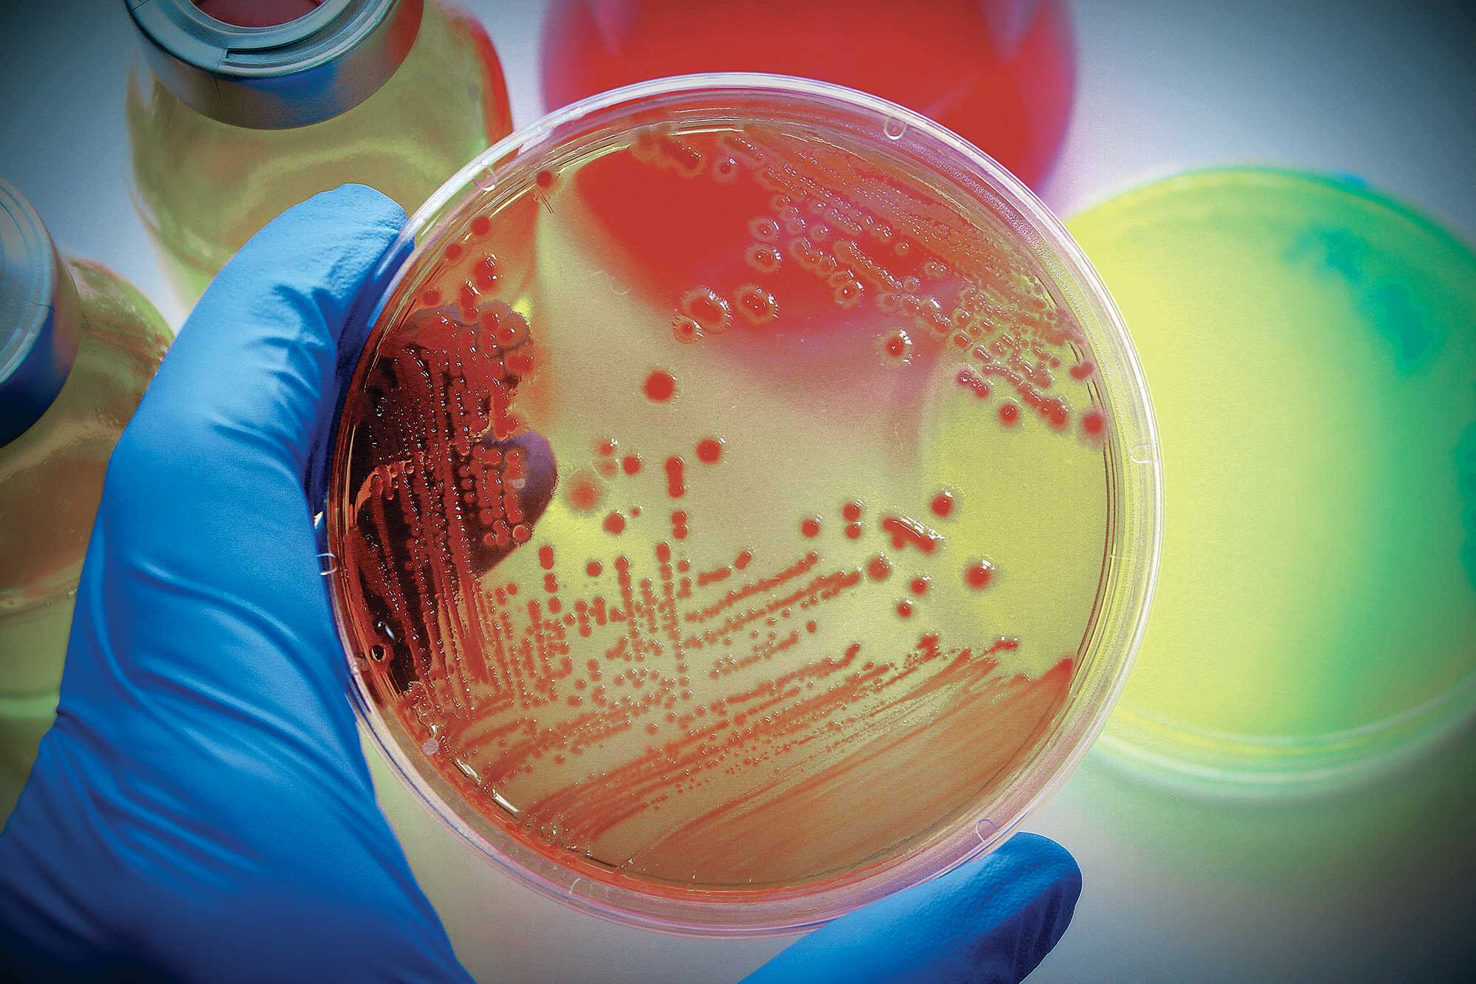



Where can it take me for university?
GCSE Food Preparation and Nutrition provides a core of knowledge which is advantageous if pursuing further studies in Science-related A levels and beyond.
Food Science & Innovation
Food Science
Human Nutrition
Food Business Management
Food Technology & Product Development
Nutrition & Public Health
Food Marketing
Nutritional Therapy

Slide 17
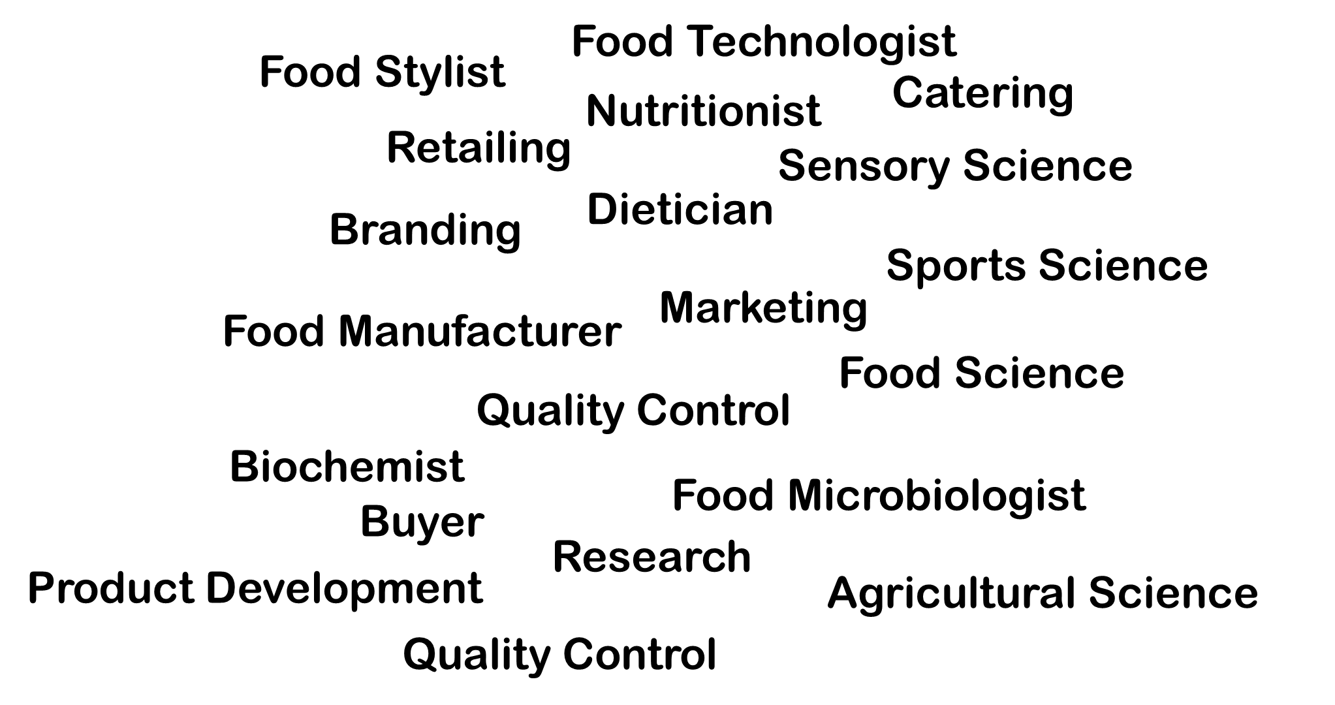
Where can it take me for a career?
Food Preparation and Nutrition GCSE provides an excellent grounding in practical food skills and nutrition that you will use every day, no matter what career choice.
The course could also lead to a whole host of careers in the hospitality industry.

Slide 18
Are you interested in current food and nutrition issues?
Do you enjoy working with food?
Do you Like a practical challenge?
Do you enjoy food science and want to know more about the function of ingredients?
If you answered yes to these questions, then Food Preparation and Nutrition is the course for you!

Slide 19

If you would like any further information about the course please email:
Exam Board: AQA Syllabus 8585
www.aqa.org.uk/subjects/food-preparation-and-nutrition/gcse/food-preparation-and-nutrition-8585

