Slide 1
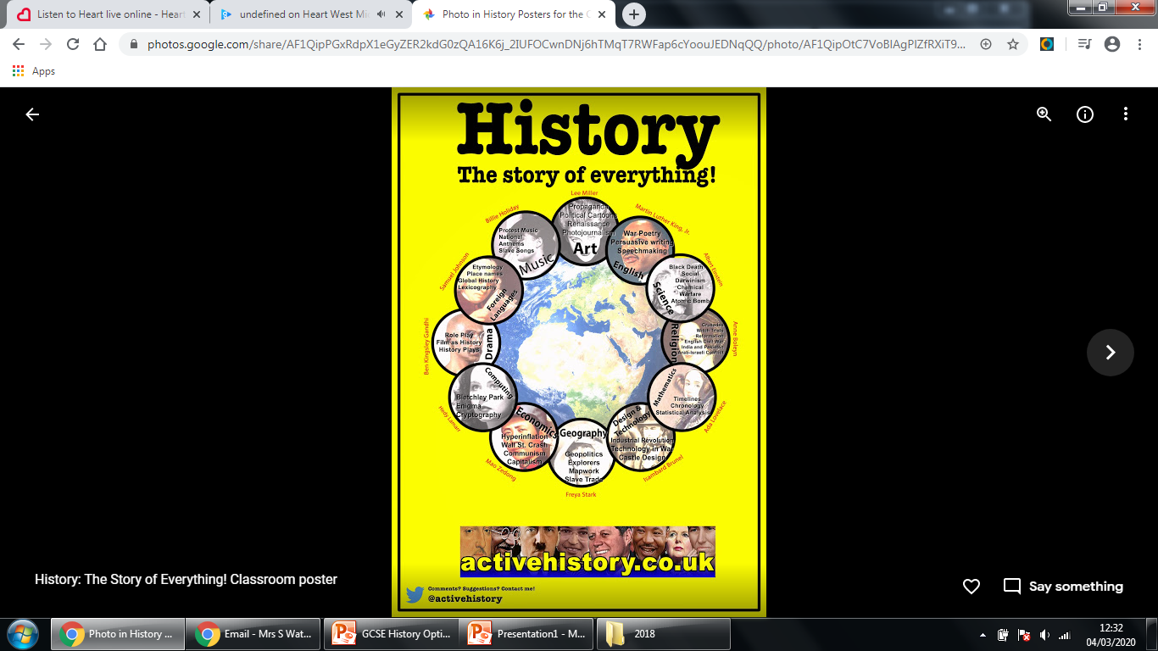

Slide 2
Why pick History?
People who have studied History at university often go on to become lawyers, accountants, journalists, teachers, civil servants, academics, bankers, librarians and lots of other things.
History gives us skills to learn to think, to investigate, analyse, develop writing skills, argue a case, learn research skills, formulate and test hypotheses and understand the world around us!
GCSE history shows that you have good written, oral and analytical skills, which are all things employers want to see.

Slide 3
Why do employers value history?
Employers want people who are….
Independent thinkers
Open minded
Disciplined
Good at problem solving
Able to pick out the essential from the trivial.
Take a look at some of the famous people who have history degrees.

Slide 4
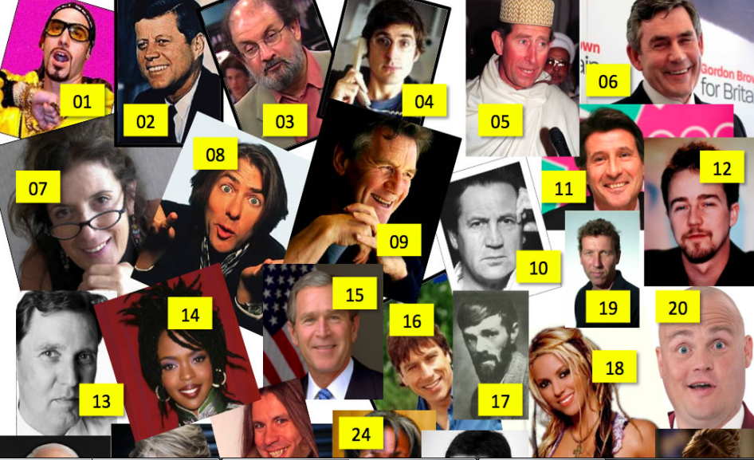
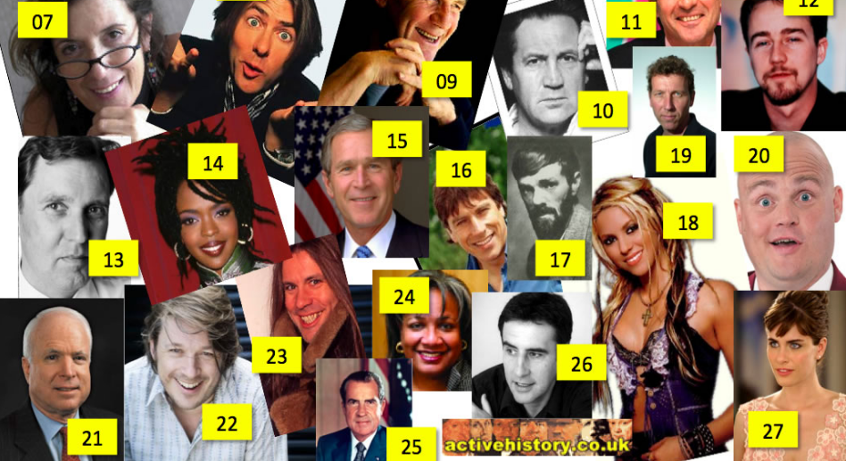
Famous Historians

Slide 5
My main message:
Choose it because you enjoy it!

Slide 6
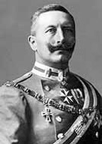
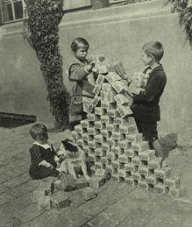
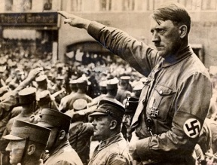
Paper 1
Germany, 1890–1945: Democracy and Dictatorship
Why was Kaiser Wilhelm obsessed with the military?
Why were children allowed to play with billion dollar notes in 1923?
How was Hitler able to convince people that blue eyes and blonde hair was the ‘master race’ when he himself didn’t fit into this?

Slide 7
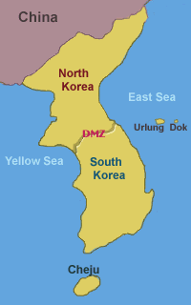
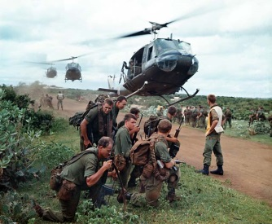
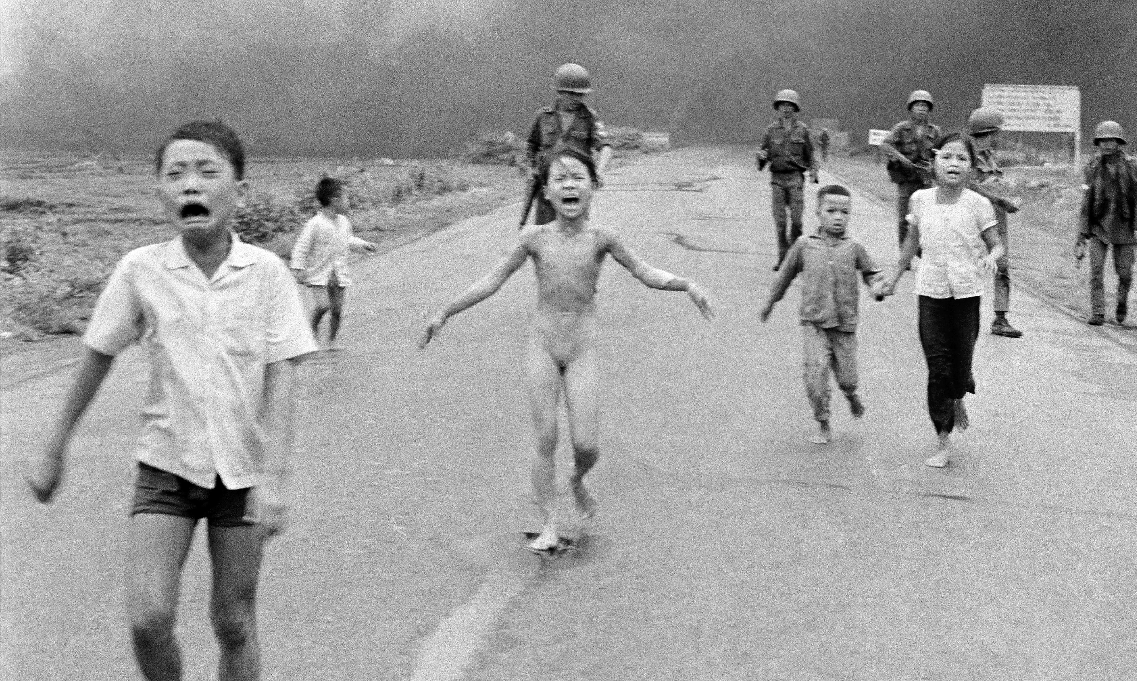
Paper 1
Conflict and tension in Asia, 1950–1975
How did the Korean War play a part in the Cold War?
What led Buddhist monks to burn themselves alive in protest?
What led American students to chant the following at their president: ‘Hey, hey LBJ, how many kids have you killed today?’

Slide 8
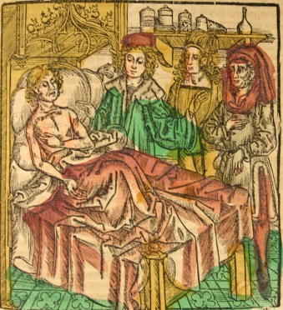
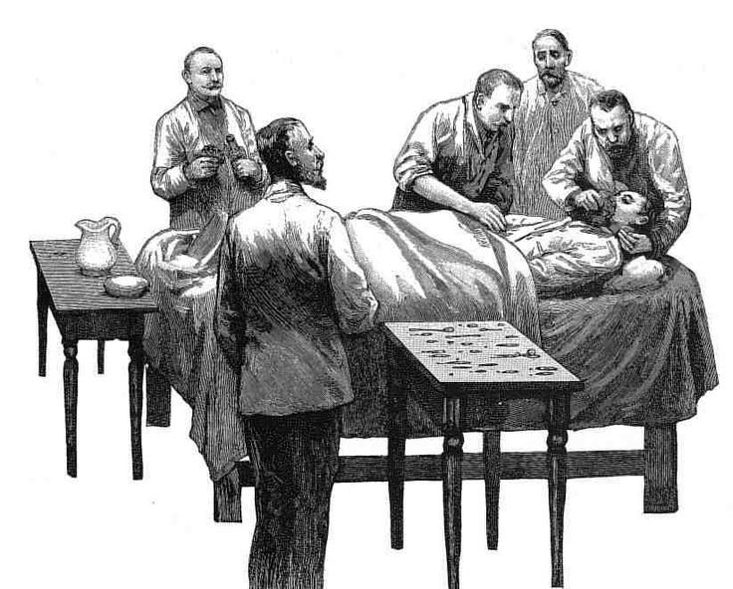
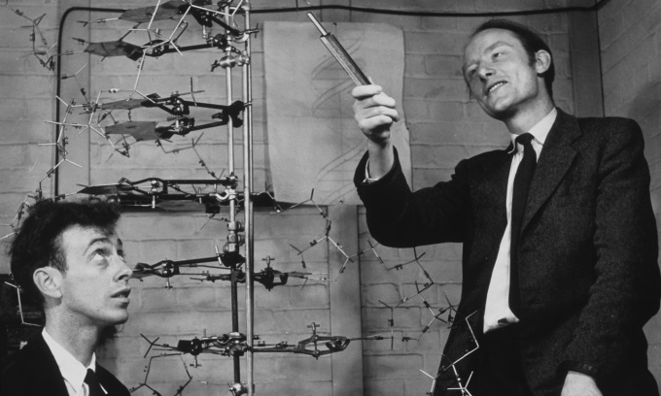
Paper 2
Britain: Health and the people: c1000 to the present day
Why did people believe slapping a pigeon against the soles of their feet would cure them?
Why does the word ‘vacca’ for vaccination come from the word ‘cow’?
Who were the ‘guinea pig club’ and why were they so revolutionary?
How did a dirty lab and an open window lead to the discovery of antibiotics?

Slide 9
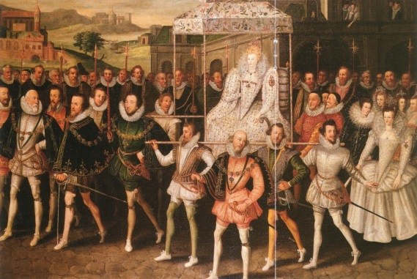
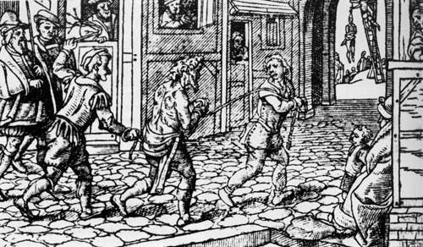
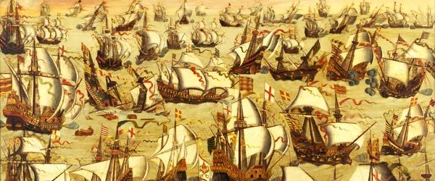
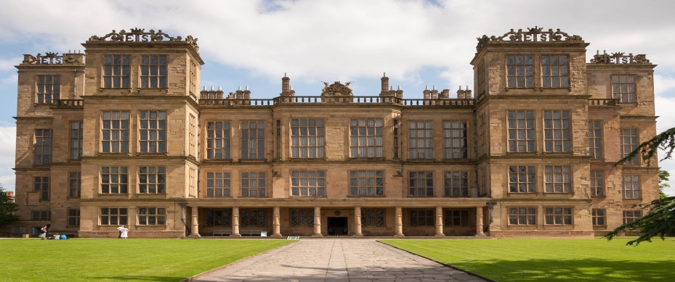
Paper 2
Elizabethan England, c1568–1603
How did a ‘bastard’ princess become one of the nations most successful queens?
What is the different between a vagabond and a bawdy basket?
Did the murder of a Scottish Queen lead to the biggest naval invasion in British history?
Why were people prepared to pay a £60,000 tax on their windows?

Slide 10
GCSE History
Course Content
Paper 1: Understanding the modern world
Section A: Period studies: Germany, 1890–1945: Democracy and dictatorship
Section B: Wider world depth studies: Conflict and tension in Asia, 1950–1975
Paper 2: Shaping the nation
Section A: Thematic studies: Britain: Health and the people, c1000 to the present day
Section B: British depth studies including the historic environment : Elizabethan England, c1568–1603

Slide 11
What are the requirements for GCSE History?
Short (depth study) Korea and Vietnam
Medium (period study), taught through Germany and Elizabeth
Long (thematic), taught through Medicine Through Time
STUDENTS SHOULD HAVE THE OPPORTUNITY TO STUDY…
a locality (the historic environment); with a focus on the site within its context, showing its relationship with historical events and developments
40% British history
European/Wider world history

Slide 12
What skills will we be using?
Assessment Objective | Weighting | Target
AO1 | 35% | Knowledge and understanding
AO2 | 35% | Key concepts
AO3 | 15% | Source analysis
AO4 | 15% | Interpretations

Slide 13
How will pupils be assessed?
Two exams– one for each component
Both 2 hours long
Both 84 marks (inc 4 SPAG marks on each)
Both worth 50% of the overall assessment
Both exams will be sat at the end of year 11

Slide 14
Making sense of the History papers
Topics taught in year 10
Topics taught in year 11
Paper 1: Germany, 1890-1945: Democracy and dictatorship
1 Germany and the growth of democracy
2 Germany and the Depression
3 The experiences of Germans under the Nazis
Paper 1: Conflict and tension in Asia, 1950-1975
1 Conflict in Korea
2 Escalation of conflict in Vietnam
3 The ending of conflict in Vietnam
Paper 2: Elizabethan England, c1568-1603
1 Elizabeth's court and Parliament
2 Life in Elizabethan times
3 Troubles at home and abroad
4 The historical environment of Elizabethan England (TRIP!)
Paper 2: Britain: Health and the people
1 Medicine stands still
2 The beginnings of change
3 A revolution in medicine
4 Modern medicine

Slide 15
Simply put…
Why have we chosen AQA History over the other exam boards?
There are 2 exams rather than 3
The topics are familiar to some of those we teach in years 7,8 and 9 which therefore provides some prior knowledge
The topics are very varied and interesting
The style of questions are simpler than some other exam boards i.e. there are less hidden questions in the question!
As a department we are confident in our own knowledge in the topics in which we have to teach.
We think that a History GCSE is important and relevant to your son/daughter because…
History challenges key events that have taken place in History
It provides a balanced perspective on key issues in society
It provides children with analytical skills that can help for summaries of data etc.
History develops communication skills that are vital in many professions
History is highly valued by colleges and universities

Slide 16
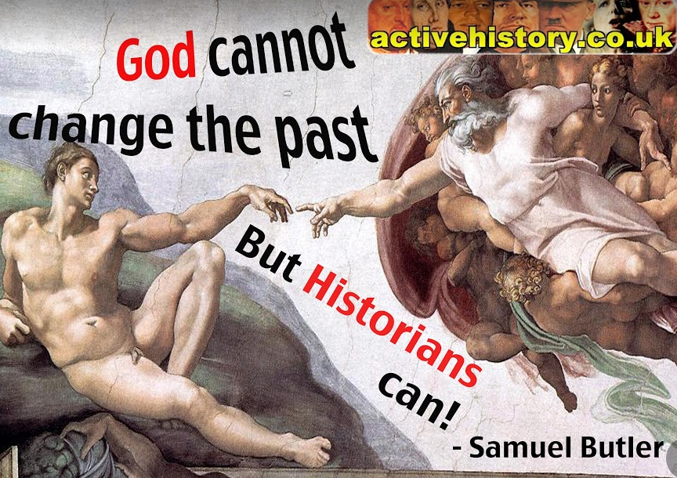

Slide 17
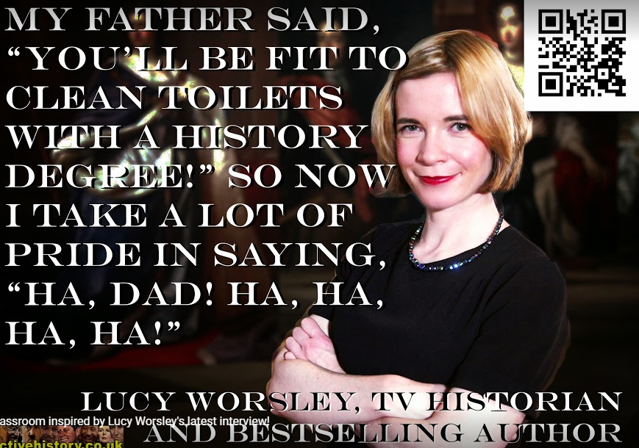

Slide 18
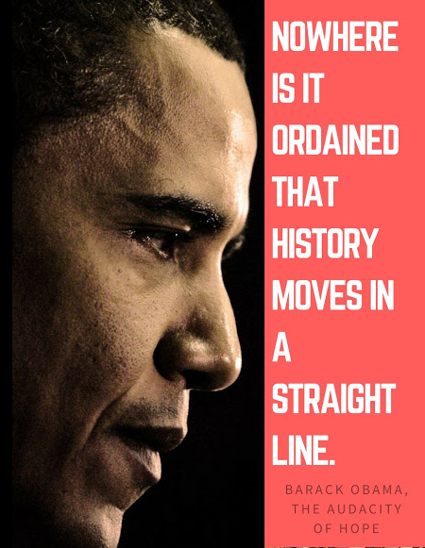

Slide 19
