Slide 1

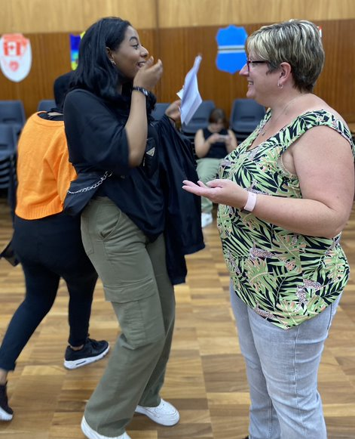
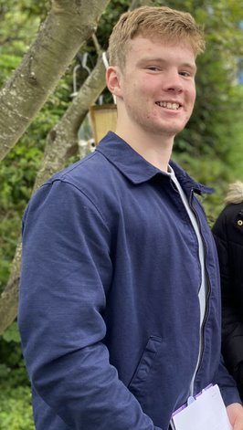
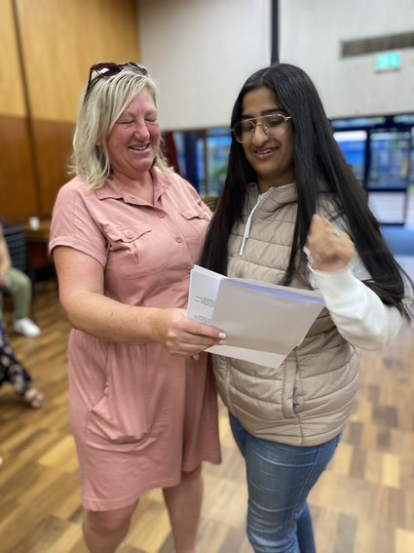
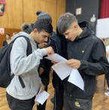
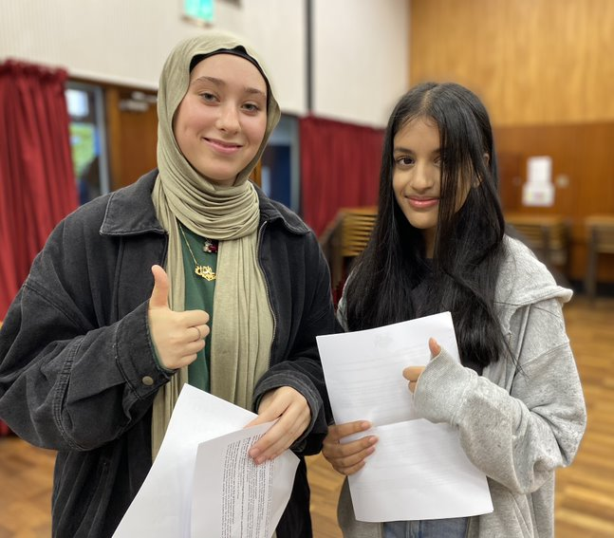
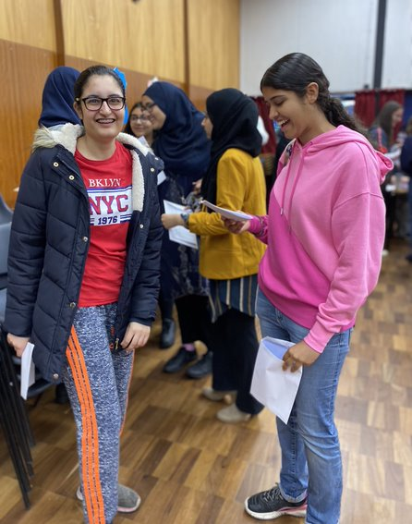
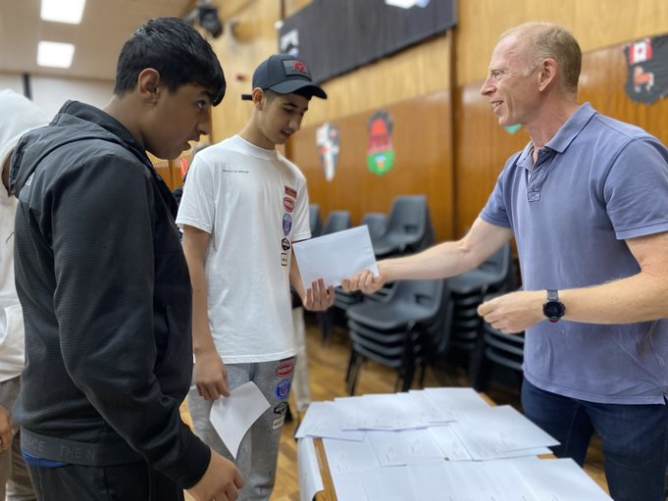
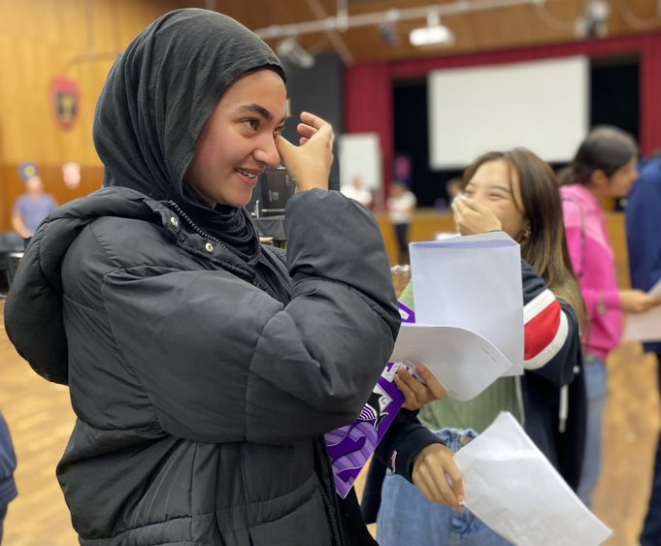
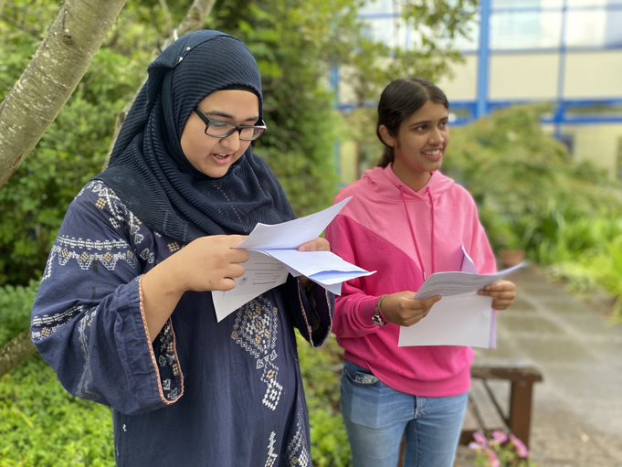
“Learning together, shaping the future”
Notes:
Excited and proud

Slide 2
Session Aims:
Look at the biggest factors to success
Provide an insight into what we share with pupils
Gain an understanding of the revision methods we share at HGS and how you can support these at home
Share resources and links
Understand the issues you face

Slide 3


In 2019 and 2022, our top performing girl and top performing boy scored 4 grades above target…

Slide 4
In 2019 and 2022, our top performing girl and top performing boy scored 4 grades above target…
In every subject they took…

Slide 5
How many brain cells did each of these two people have?

Slide 6
The biggest contributors to success:
Attitude to learning
Attendance
A Growth Mind Set
Independent study

Slide 7

Notes:
Question - So what will you need to do between now and next June? Answers
Question - What should you being doing now?
Question – so if you know what to do, which are you actually doing now? Which did you do this week? Honestly?

Slide 8
What do I need to do to succeed in my exams?
Know what I need to do
Get prepared
Work hard
Fully focus when I am revising/in lessons
Listen to feedback and advice
Act on feedback and advice
Work out what you need to get better at
Get better at it!
Do all of this again
And again
And again….
Notes:
List
You know what to do – you’ve just got to do it…
PLCs – what topics don’t you know – majority of Ds (or 3s) are because they missed some questions, not that their better answers weren’t C (4s) grade.
Learning curve
We acquire knowledge through repetition – work harder at this, but the entire GCSE Business textbook easy – 3 groups a year for 15 – 45 - repetition

Slide 9
1 | Fully Engaged! | Has high standards and a clear desire to succeed Comes fully prepared to class, with the right books and equipment, on time and ready to learn Takes responsibility for own learning, asking questions when unsure Doesn’t give up in the face of difficulties, acts on feedback and tries not to repeat mistakes Works well in a team & promotes a good learning environment Takes pride in work and presents it to the best of their ability Completes all homework & gap tasks Catches up on missed work Works independently to prepare for assessments | Success and achieving targets Praise/reward
2 | Mostly Engaged | Achieves some of the above, but needs to achieve more to secure a 1 | Learning conversation (Form Tutor)
3 | Behavioural Issue | Disrupting the learning of others Disengaged from own learning | HoH involved
Notes:
Mr Adams introduced this – what you need to do and what we know leads to success – that’s why we introduced
If you keep getting 1s for AtL you’ll do the best you can….no one can ask for anymore

Slide 10


Slide 11
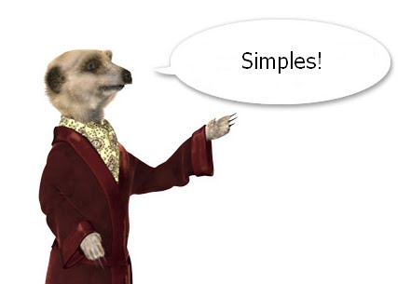
Notes:
You know what to do – you’ve just got to do it…

Slide 12
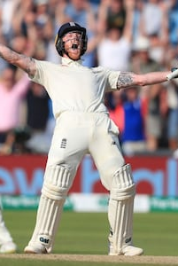

What do these sports people have in common?
Notes:
Both cricketers. Both have scored two centuries in current ashes series.

Slide 13
The Process…

Slide 14
Approach to homework | Approach to homework
Do it on the day set
Make notes in class
Ask if unsure
Allocate enough time to complete work
Sit down at a time when you are alert
Turn off phone / avoid time stealers
Ask parent/older brother or sister to check
Commit to doing your best, accept the outcome and learn from the feedback

Slide 15
Approach to homework | Approach to homework
Do it on the day set | Leave it until last minute
Make notes in class | Don’t concentrate when being set
Ask if unsure | Don’t ask for help or check class charts
Allocate enough time to complete work | Rush after Liverpool v Manchester United on telly and bedtime
Sit down at a time when you are alert | Do when tired and grumpy
Turn off phone / avoid time stealers | Whats App your mate a funny video
Ask parent/older brother or sister to check | Hand in without checking
Commit to doing your best, accept the outcome and learn from the feedback | Moan about mark and feel disheartened

Slide 16
Approach to homework | Approach to homework
Do it on the day set | Leave it until last minute
Make notes in class | Don’t concentrate when being set
Ask if unsure | Don’t ask for help
Allocate enough time to complete work | Rush after Liverpool v Manchester United on telly and bedtime
Sit down at a time when you are alert | Do when tired and grumpy
Turn off phone / avoid time stealers | Whats App your mate a funny video
Ask parent/older brother or sister to check | Hand in without checking
Commit to doing your best, accept the outcome and learn from the feedback | Moan about mark and feel disheartened

Slide 17


Approach to homework | Approach to homework
Do it on the day set | Leave it until last minute
Make notes in class | Don’t concentrate when being set
Ask if unsure | Don’t ask for help
Allocate enough time to complete work | Rush after Liverpool v Manchester United on telly and bedtime
Sit down at a time when you are alert | Do when tired and grumpy
Turn off phone / avoid time stealers | Whats App your mate a funny video
Ask parent/older brother or sister to check | Hand in without checking
Commit to doing your best, accept the outcome and learn from the feedback | Moan about mark and feel disheartened

Slide 18
2. Attendance

Slide 19
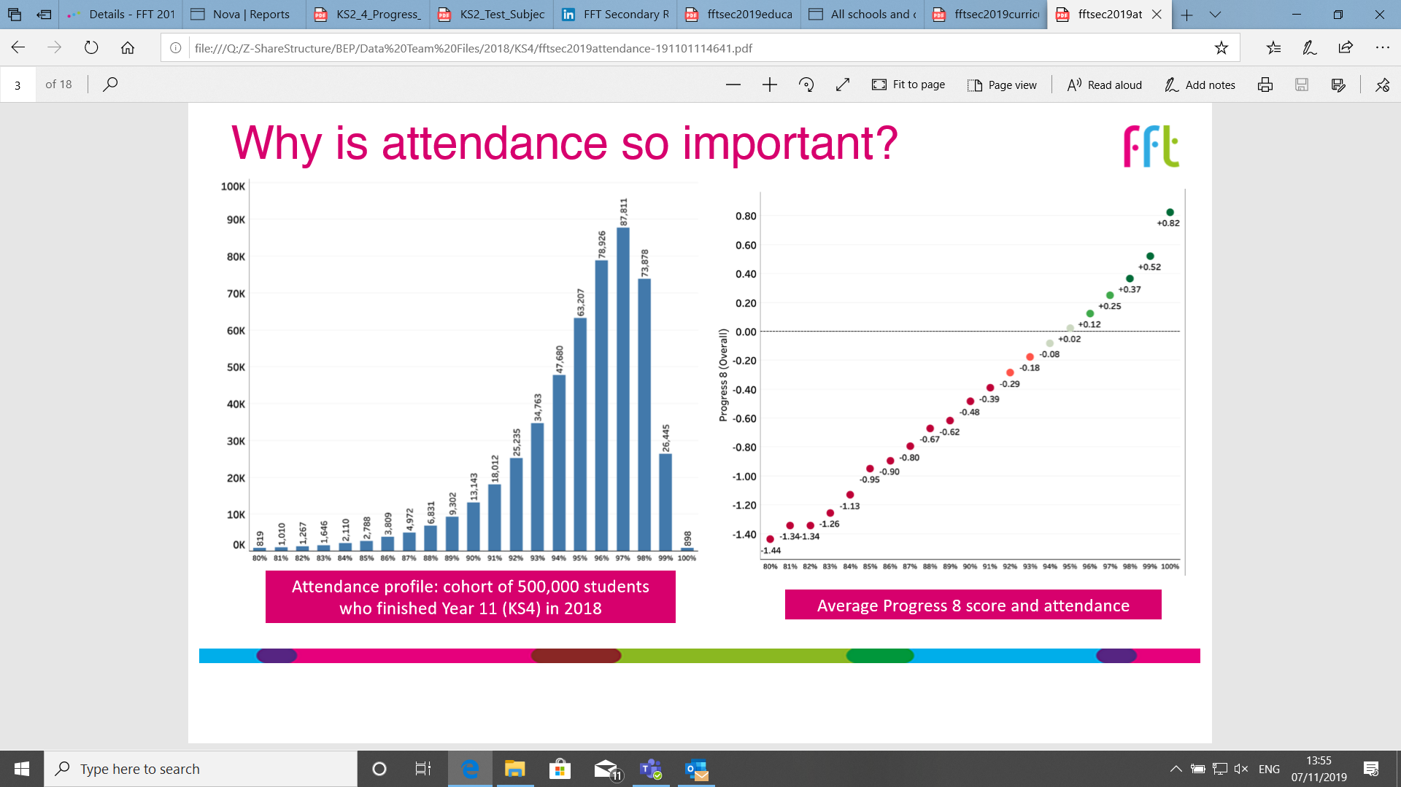
Why is attendance so important?

Slide 20
3. A Growth Mind Set

Slide 21
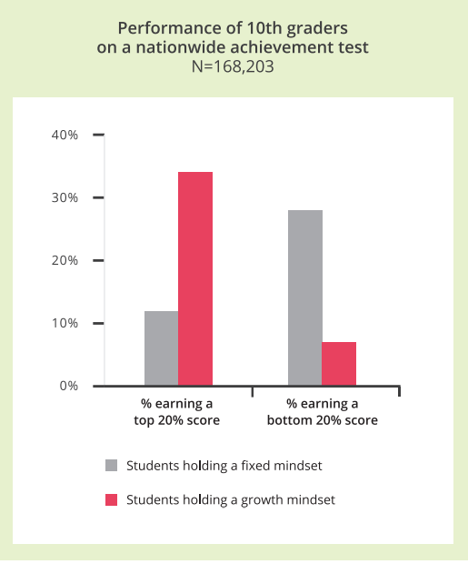
Does your mindset matter?
Research with 168,000 year 10 students showed that those with a growth mindset were three times more likely to score in the top 20% in a maths test.
Those with a fixed mindset were four times more likely to score in the bottom 20%.

Slide 22
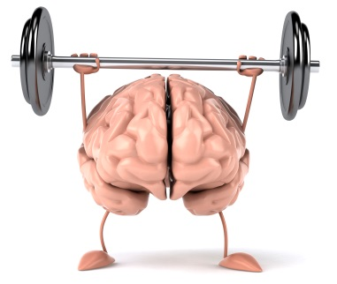
Fixed mindset may say… | Growth mindset might reply…
If I don’t even try, I won’t look silly when I fail | If I don’t even try, I fail automatically
I’d be finding this easy if I really had talent | Basketball wasn’t easy for Michael Jordan. He had a passion and put in lots of effort.
(When you are criticised)… This wasn’t my fault, it was because of… | If I don’t take responsibility, I can’t put it right. Let me listen and learn what I can…
I’ll never be as clever as her… . | I’m going to learn how she does it so I can too!
Keep calm and have a growth mindset!

Slide 23
Independent Study

Slide 24
Exams are stressful, but what creates stress and how can we reduce it?

Slide 25


Slide 26
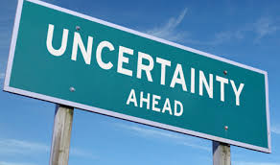

Slide 27
The time line to your first exam on Monday 10th May 2021
Autumn Term (13 weeks left) | Spring Term (12 weeks) | Summer Term (3 weeks?) | June 12th – or maybe July 12th
Class Work and Homework | Class Work and Homework | Question practice for the final exams | Chillax – enjoy your longest holiday until 2080!
Revision for October Mocks and Unit Tests | Revision for Unit Tests and second set of Mock exams.
Completing controlled assessment | Completing Controlled Assessment
Completing college applications
Notes:
The mocks are vital – start revising NOW – this weekend – make revising at the weekend a habit. Sunday morning 9-12, 3 x 45 minute revision sessions – Just Do It
Complete controlled assessment
College – get them done
Then 11 weeks, then 4….
28 weeks off school left!

Slide 28
The time line…
28 school weeks x 10 revision sessions = 280 revision sessions
6 weeks of holiday x 25 revision sessions = 150 revision sessions.
Autumn Term (9 weeks left) | Spring Term (13 weeks) | Summer Term (2 weeks) | June 27th Onwards
Class Work and Homework | Class Work and Homework | Question practice for the final exams | Chillax – enjoy your longest holiday until 2080!
Revision for December Mocks and Unit Tests | Revision for Unit Tests and second set of Mock exams.
Completing controlled assessment | Completing Controlled Assessment
Completing college applications
Notes:
The mocks are vital – start revising NOW – this weekend – make revising at the weekend a habit. Sunday morning 9-12, 3 x 45 minute revision sessions – Just Do It
Complete controlled assessment
College – get them done
Then 11 weeks, then 4….
28 weeks off school left!

Slide 29
The time line…
430 potential revision sessions between now and your first exam next May.
Autumn Term (9 weeks left) | Spring Term (13 weeks) | Summer Term (2 weeks) | June 27th Onwards
Class Work and Homework | Class Work and Homework | Question practice for the final exams | Chillax – enjoy your longest holiday until 2080!
Revision for December Mocks and Unit Tests | Revision for Unit Tests and second set of Mock exams.
Completing controlled assessment | Completing Controlled Assessment
Completing college applications
Notes:
The mocks are vital – start revising NOW – this weekend – make revising at the weekend a habit. Sunday morning 9-12, 3 x 45 minute revision sessions – Just Do It
Complete controlled assessment
College – get them done
Then 11 weeks, then 4….
28 weeks off school left!

Slide 30
Staying Motivated!!!
Break the task down into manageable chunks - (use unit titles to help)
1
Surround yourself with positive people
3
Get into a study routine – make it a norm
2

Slide 31
Independent Study
Reading is the least efficient way of revising
If you only look at something once you will forget it
You need to revise something 5 times to recall most of it
Revision should be interactive, using mind maps, mnemonics, flash cards, colour, tweets and song!
Revision sessions should be 45 minutes long with all time stealers switched off
Start early and build up good revision notes (Cornell note taking) so that you can save the final stages of revision for past paper practice
Make sure you cover the whole syllabus.

Slide 32
Independent Study
Reading is the least efficient way of revising
If you only look at something once you will forget it
You need to revise something 5 times to recall most of it
Revision should be interactive, using mind maps, mnemonics, flash cards, colour, tweets and song!
Revision sessions should be 45 minutes long with all time stealers switched off
Start early and build up good revision notes (Cornell note taking) so that you can save the final stages of revision for past paper practice
Make sure you cover the whole syllabus.

Slide 33
Cornell Notes
Please watch the clip on taking Cornell notes – this is the note taking system we use in school to help pupils in all years revise. I blank Cornell notes sheet is on the school website for you to download. Yr 11 pupils all have Cornell note pads.

Slide 34
Flash Cards

Slide 35
Amount of info – not too much, not too little
Appearance – add colours and quick and simple images that could aid memory
Neatly structured – well-organised info is easier to remember
Mnemonic device – Can you use a memory tool of some kind?
A rhyme/silly phrase/acronym etc

Slide 36
Summary
FRONT
BACK
Info you’re trying to learn on this side
Abbreviate! (try no to write full sentences)
Make sure it’s neatly structured
Add SIMPLE, QUICK IMAGES and MNEMONICS*
*Don’t worry if you can’t think of an image and a mnemonic for every card you create
Questions on this side relate to the info on the front
This is the most important part of making a good flash card
Write hard questions to put yourself under pressure when testing yourself
Try starting questions with ‘why’ or ‘how’ as this often leads to deeper processing
2 mins to choose info – 8 mins to make it

Slide 37
Retrieval Practice
Pupils should be constantly testing their knowledge with short tests and quizzes. As a parent, you can help with this by asking your child questions from their Cornell notes or Flash cards. They will have written out the answer, so you don’t need to know it!!
Software packages such as Seneca Learning also help as they mark the pupils answers. We recommend that when pupils are learning from online resources that they continue to make notes (flash cards or Cornell notes) as this is more interactive and more effective than just reading of screen.
There are also audio packages of revision materials that pupils can download onto their phone and listen to on their walk to school or on a long car drive over the Christmas holiday!

Slide 38
2.1 Retrieval Practice – back of your books in silence
List 4 sources of finance that enable a business to expand​
What is an advantage and disadvantage of being a PLC?
List 2 ways a business can grow organically​ - what are an advantage and disadvantage of each
List 2 ways a business can grow inorganically​ - what are an advantage and disadvantage of each​
List 5 reasons why a businesses aims may change​​
Give 4 ways how a businesses aims and objectives can change
List 3 ways a business can be ethical
What are an advantage and disadvantage of being ethical
What is a trading bloc? Give an example of a trading bloc.
How could a UK business adapt its marketing mix so it can export abroad?

Slide 39
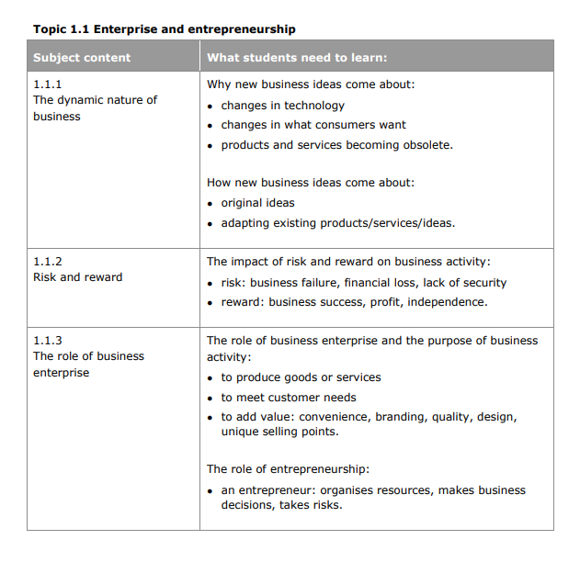
Make sure your child is using the syllabus for each of their courses to make sure they cover everything.

Slide 40
Further Online resources
BBC Bitesize
Seneca Learning
MathsWatch
Oak Academy

Slide 41
What else can I do as a parent?
Monitor penalties and praises on ClassCharts, make sure attendance is good.
Create a quite study space.
Monitor – ideally 90 minutes a night in Y11. Check Cornell notes are being completed – time stamp then!
Help by testing at home – ask the questions on one side of the Flash card or from the Cornell notes.
Encourage a growth mind set and can do attitude.
Temporarily remove Time Stealers!

Slide 42
Mon | Tues | Weds | Thurs | Fri | Sat | Sun

Slide 43
Mon | Tues | Weds | Thurs | Fri | Sat | Sun
630-730 | 630-730 | 630-730 | 630-730 | Evening off | 10-11 | 10-11
8-9 | 8-9 | 8-9 | 8-9 | Evening off | 1130-1230 | 1130-1230
 |  |  |  |  | 6-7 | 6-7

Slide 44
Mon | Tues | Weds | Thurs | Fri | Sat | Sun
630-730 | 630-730 | 630-730 | 630-730 | Evening off | 10-11 | 10-11
8-9 | 8-9 | 8-9 | 8-9 | Evening off | 1130-1230 | 1130-1230
 |  |  |  |  | 6-7 | 6-7
Maths
Science: Bio
Geog
Maths
Science: Chem
RE
English Lang
Maths
Business Studies
English Lit
English Lang
Maths
KS4 timetable
Science: Phys
Maths

Slide 45
Mon | Tues | Weds | Thurs | Fri | Sat | Sun
430-515 | 430-515 | 430-515 | 430-515 | Evening off | 10-11 | 10-11
7-8 | 7-8 | 7-8 | Evening off | Evening off | 1130-1230 | 1130-1230
Maths Watch
homework
homework
homework
homework
Independent reading
Independent Science
Independent History
Independent RE
Independent Geography
Independent maths
KS3 timetable

Slide 46
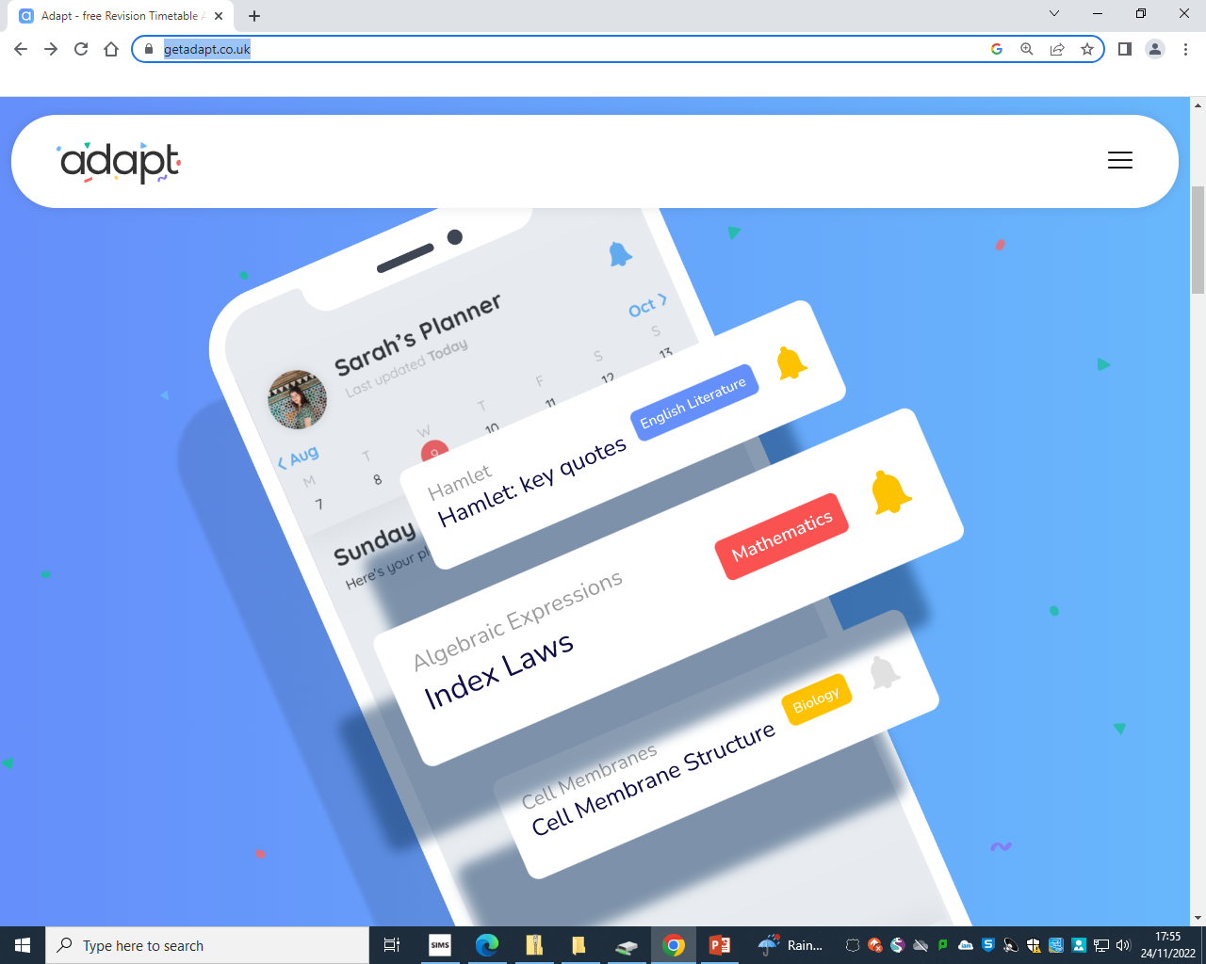
https://getadapt.co.uk/plus

Slide 47
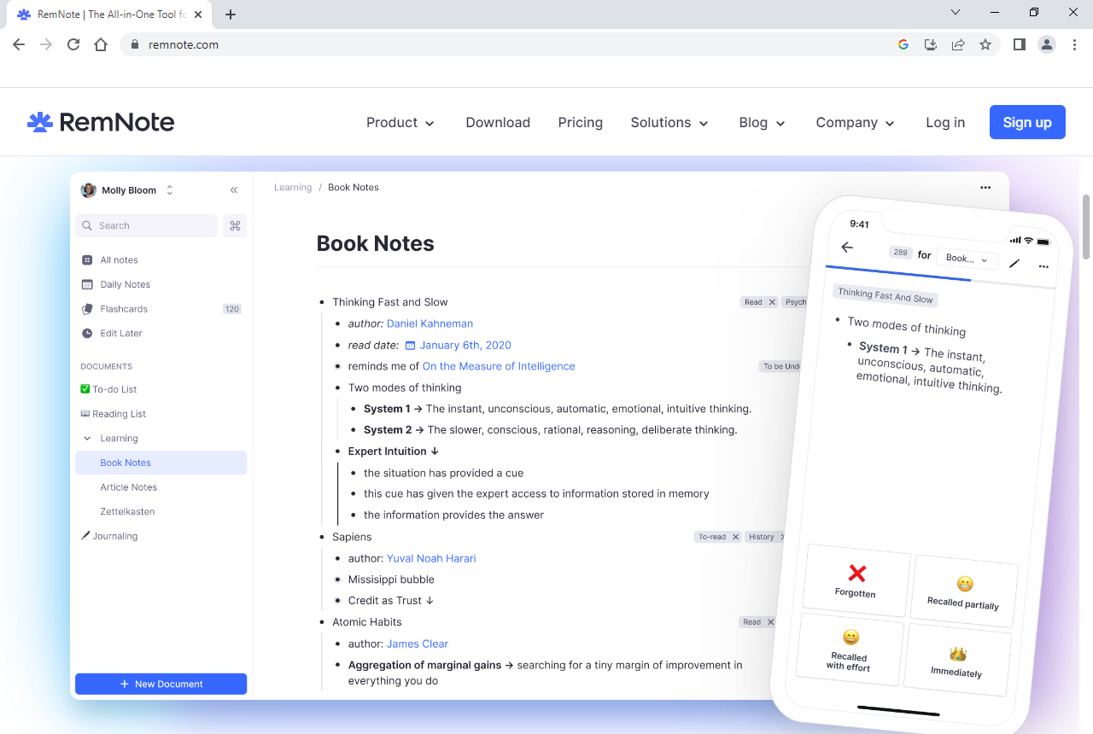
https://www.remnote.com
Ziebeckjasmine@gmail.com
Jasmine08

Slide 48
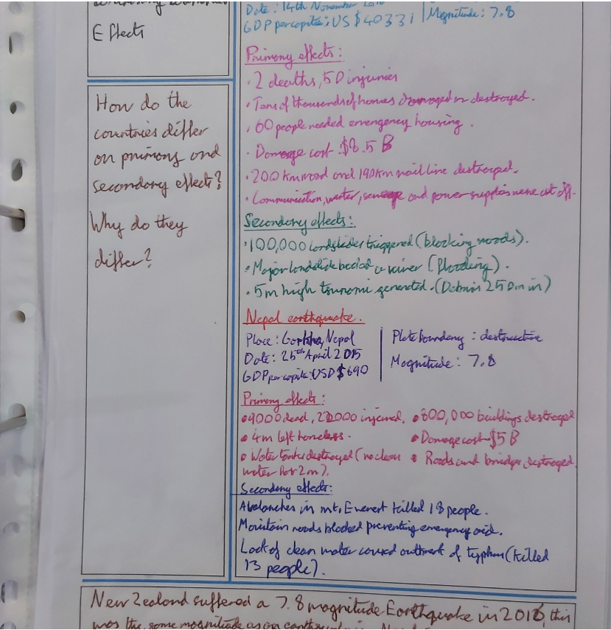
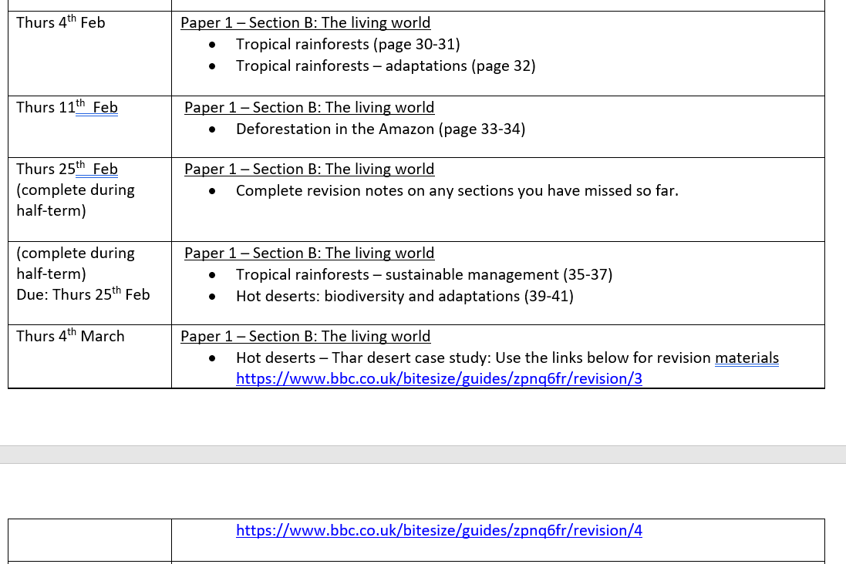
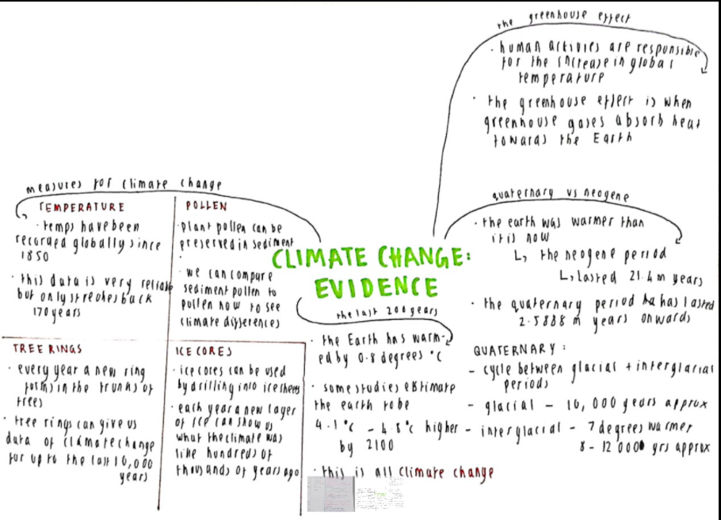
Geography
https://www.bbc.co.uk/bitesize/guides/zpnq6fr/revision/3

Slide 49


