Slide 1
How to revise for GCSE History
Miss Lewis
Head of History

Slide 2
Course Structure
x2 two-hour exams in total.
Thursday 18th May (AM)
Wednesday 7th June (PM)
Paper 1 – Understanding the modern world (50% of final grade)
Section A – Germany, 1890-1945
Section B – Conflict and tension in Asia, 1950-1975.
Paper 2 – Shaping the Nation (50% of final grade)
Health and the people, c1000-present day
Elizabethan England, 1568-1603

Slide 3
Specification and checklists
https://www.aqa.org.uk/subjects/history/gcse/history-8145/specification-at-a-glance

Slide 4
Theme or period.
Specific knowledge needed to understand and explain (CK).
RED – Uncertain
AMBER – Somewhat
GREEN - Secure

Slide 5
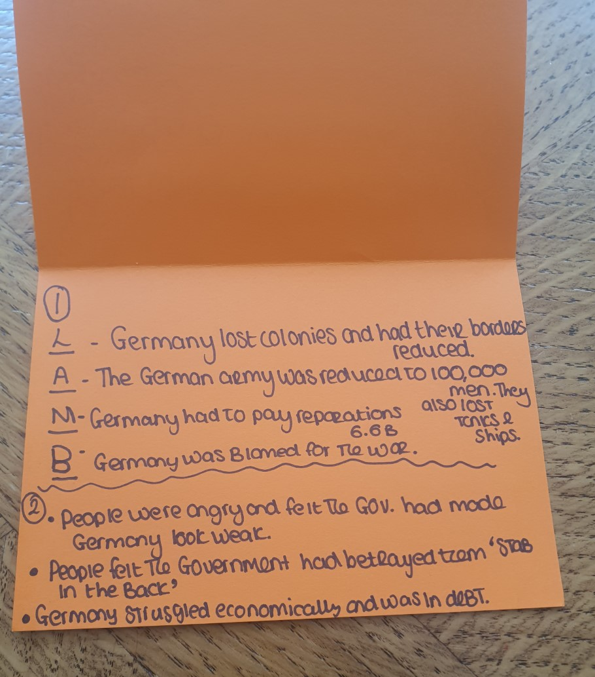
Flashcards
Acronyms, symbols, and images.

Slide 6
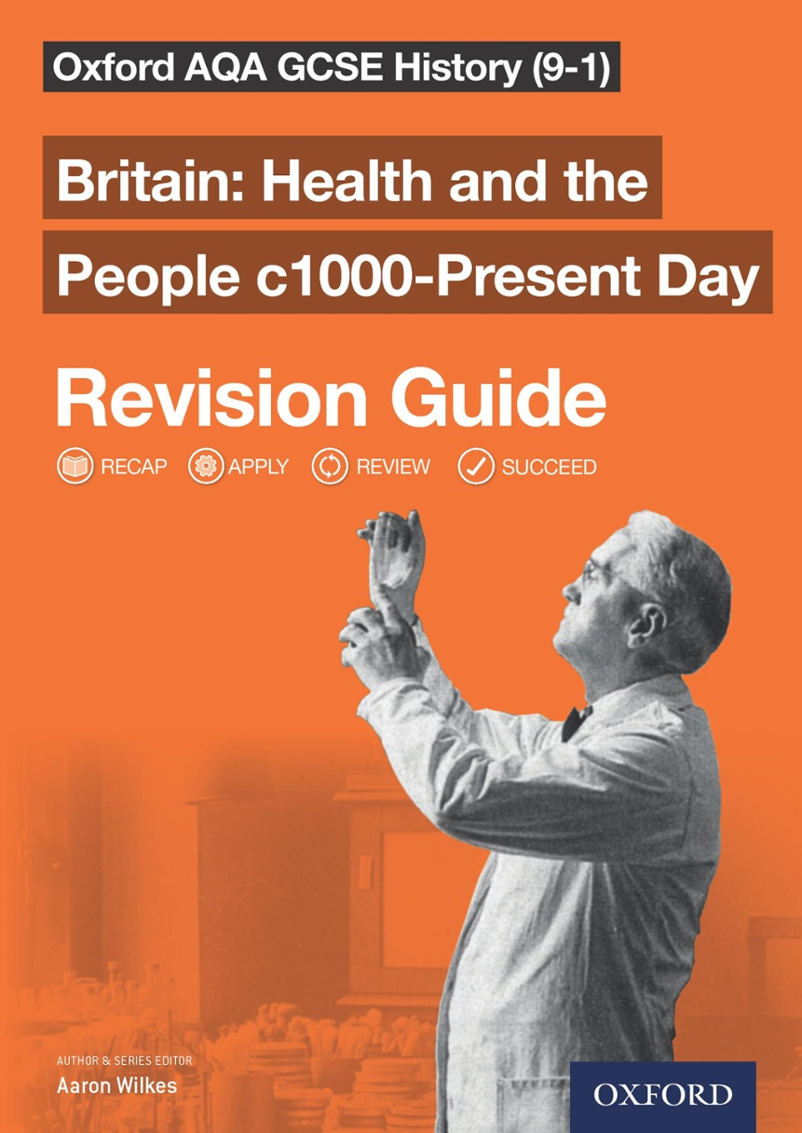
Revision Resources
Revision Guides – available on Amazon/eBay.
Booklets – available on class charts.
GCSE Pod – available on class charts and student common.
Topic timelines – see a member of the History department.

Slide 7
Useful websites
https://www.bbc.co.uk/bitesize/examspecs/zxjk4j6 - BBC Bitesize.
https://app.senecalearning.com/courses?Price=Free&Exam+Board=AQA&Subject=History - Seneca Learning.
https://continuityoak.org.uk/lessons - United Learning.
https://quizlet.com/en-gb/content/gcse-history - Quizlet (requires signup).

Slide 8
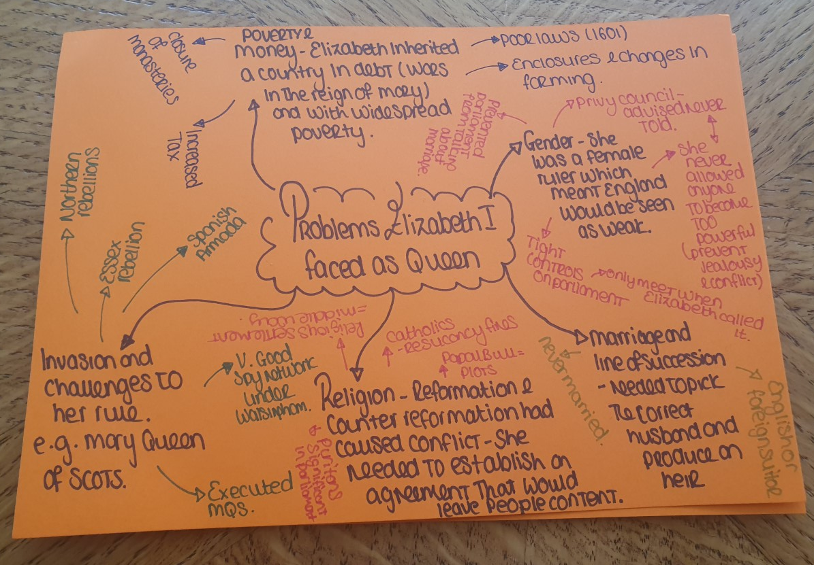
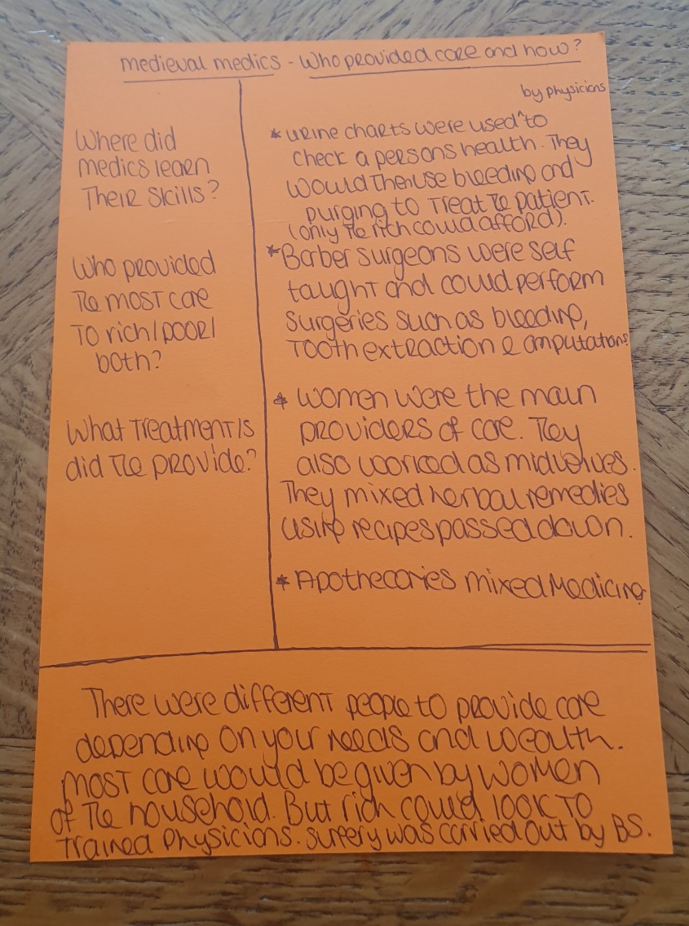
Mind-Maps and Cornell Notes

Slide 9
Exam Questions
https://www.fastpastpapers.com/GCSE_AQA_History_exam_papers.html - Fast Papers provides access to multiple past papers.
https://www.aqa.org.uk/subjects/history/gcse/history-8145/assessment-resources - AQA website has past papers and mark schemes available to download.

Slide 10
Good Luck!!
From
Ms Lewis, Miss Forster, Mr Biling, and Mr Sutheran.

