Slide 1
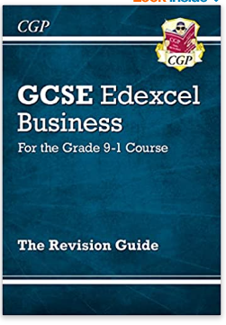
Revising Business Studies

Slide 2
There are two 1 hour 45 minute Exam Papers
Unit 1 (covered in Y10) – Investigating Small Business
Unit 2 (Covered in Y11) – Building a Business

Slide 3
Skills needed:
Knowledge of key terms
Knowledge of the advantages and disadvantages of different options
Ability to answer numeracy questions
Ability to explain using BLT (because, leads to, therefore, as a result)
Ability to apply (context)
Ability to analyse and evaluate

Slide 4
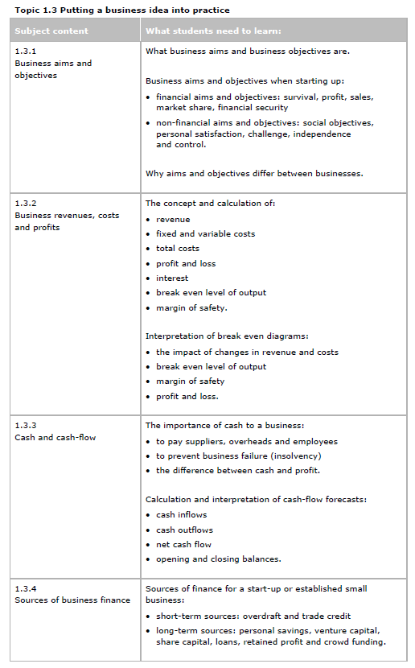

Slide 5
Source of Finance | Advantages | Disadvantages

Slide 6
Source of Finance | Advantages | Disadvantages
Personal Savings | No interest to pay and no debt | May not be enough retained profit for what you need. Risking your own £

Slide 7
Revision Resources:
The course specification for Unit 1
The course specification for Unit 2
Revision Guide
Revision Workbook
Seneca
E-Revision

Slide 8
The best way to revise from Seneca or E-Revision is to make revision notes using Flash Cards or Cornell notes whilst you are answering the questions. Both sites will mark your work and give you (and me!) feedback on how you are progressing.

Slide 9
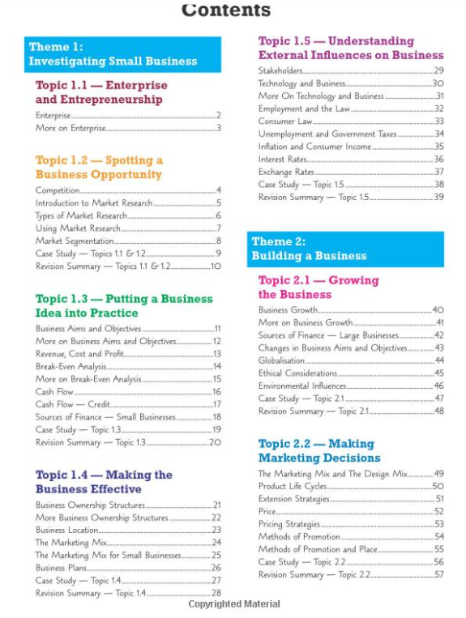
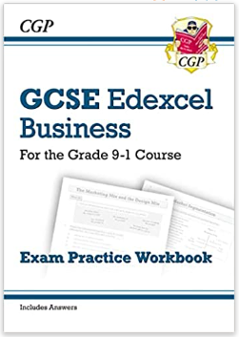

Slide 10
Exam Board Revision Resources:
Retrieval Practice Unit 1
https://qualifications.pearson.com/content/dam/pdf/GCSE/Business/2017/teaching-and-learning-materials/gcse-business-theme-1-knowledge-retrieval-revision-resources-editable-2021.zip
Retrieval Practice Unit 2
https://qualifications.pearson.com/content/dam/pdf/GCSE/Business/2017/teaching-and-learning-materials/gcse-business-theme-2-knowledge-retrieval-revision-resources-editable-2021.zip
Past Papers

Slide 11
