Slide 1
How to revise for GCSE science
Mr Clarke
Head of Science

Slide 2
Course Structure
6 exams – 2 in Biology, 2 in Chemistry, 2 in Physics.
1 paper from each science early on in the exam season and the second paper for each science near the end of the exam season.
All the scores are added up to give an overall grade.
It is a double grade, such as 4-4 or 5-5, with intermediate grades such as 5-4 counting as 1 of each grade.

Slide 3
Specification and Checklists
The specification can be found in the exam boards website. Follow this link: https://qualifications.pearson.com/en/qualifications/edexcel-gcses/sciences-2016.html
The specification contains all the information and content that the exam board could write questions on.
But it is a big document to read and understand, so the checklists are a simplified version of it.
These can be found in student common → science → checklists

Slide 4
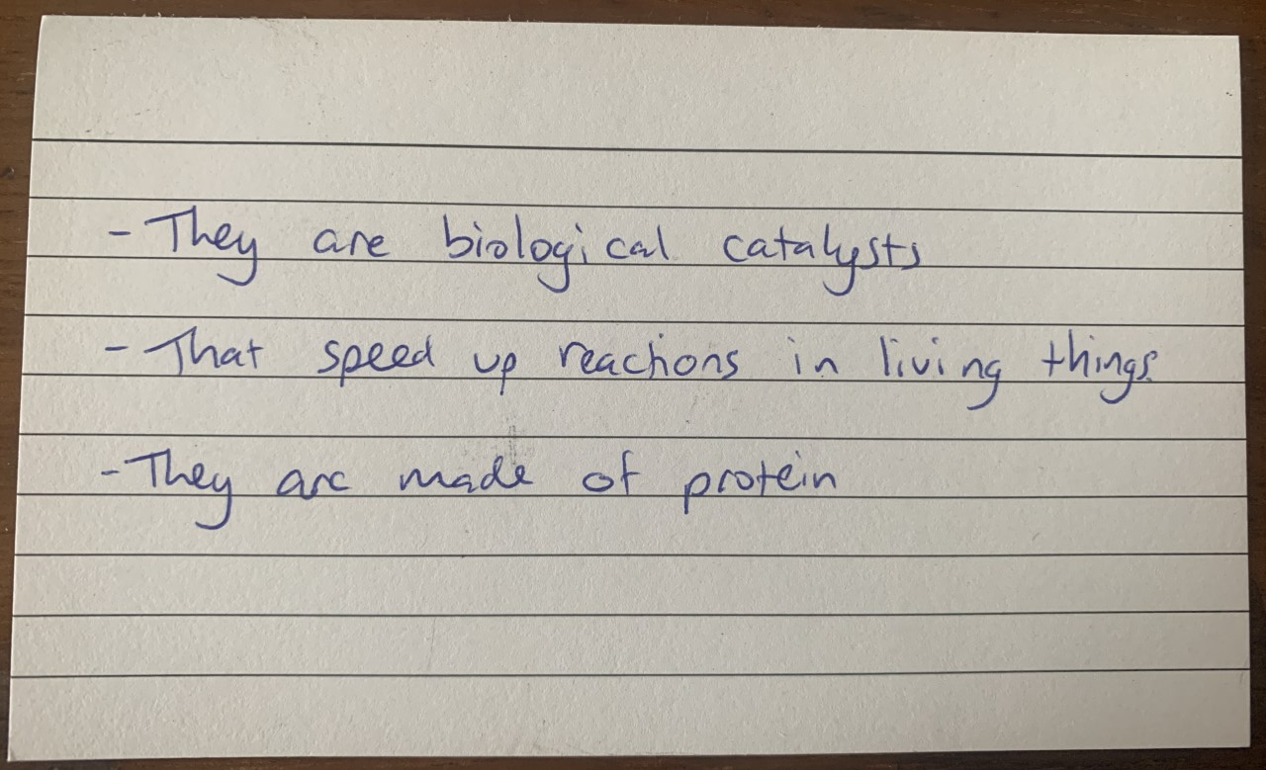
Flashcards

Slide 5
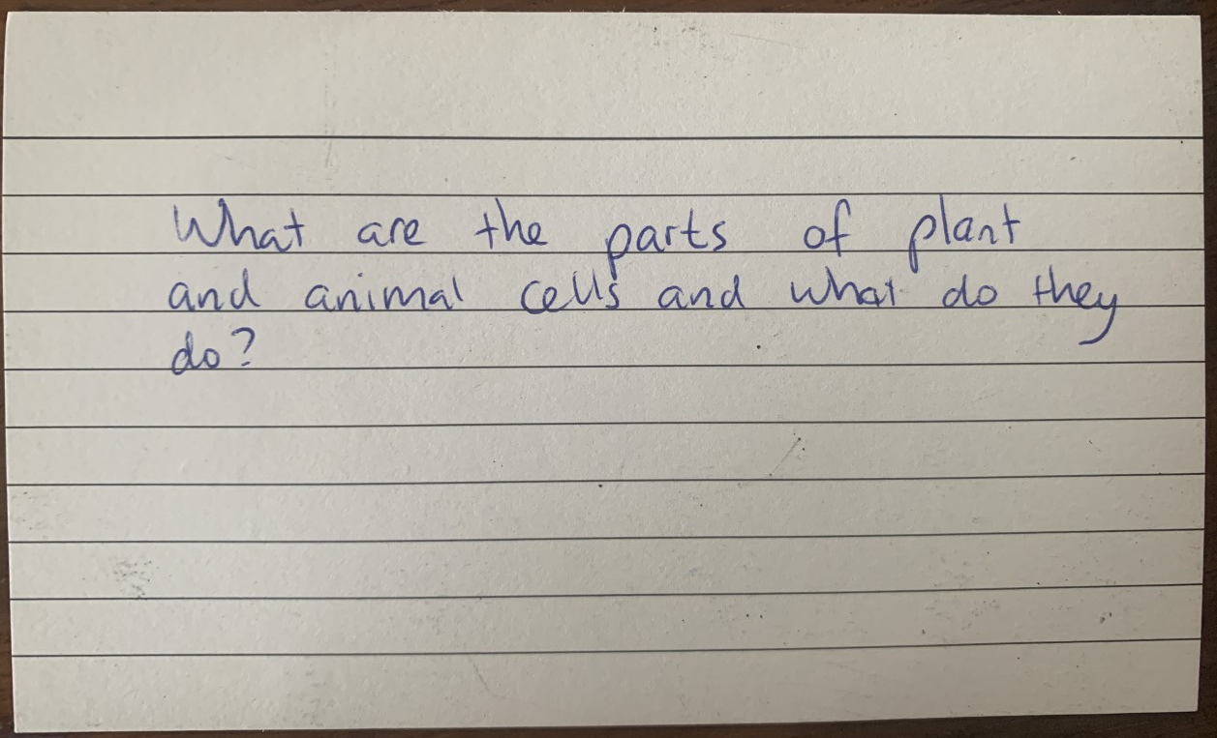
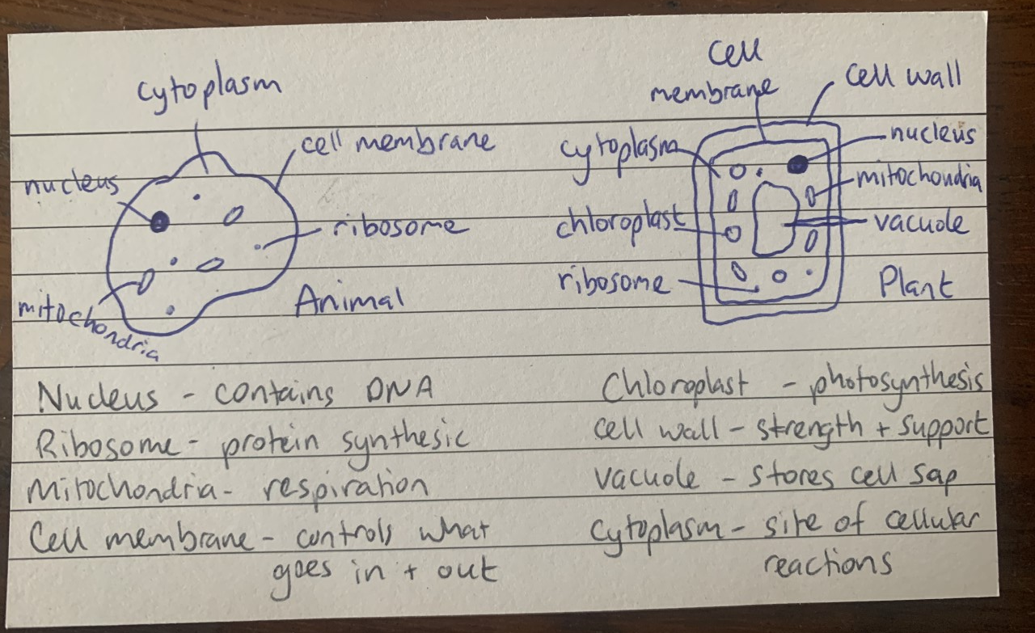
Flashcards

Slide 6
Useful websites
Seneca Learning – https://senecalearning.com/en-GB/
Cognito - https://cognitoedu.org/
BBC bitesize - https://www.bbc.co.uk/bitesize/examspecs/zqkww6f
Free Science Lessons - https://www.freesciencelessons.co.uk/
Or find the free science lessons channel on youtube

Slide 7
Past Papers
These can be accessed through the exam board website:
https://qualifications.pearson.com/en/qualifications/edexcel-gcses/sciences-2016.html

