Slide 1
How to revise for GCSE science
Mr Clarke
Head of Science

Slide 2
Course Structure
Each subject has two exams that are 1 hour 45 minutes long and worth 100 marks.
To help with the workload, most year groups will sit Chemistry in year 10 and Biology and Physics in year 11.
Students receive a grade for each subject. These grades are independent of each other.

Slide 3
Specification and Checklists
The specification can be found in the exam boards website. Follow this link: https://qualifications.pearson.com/en/qualifications/edexcel-gcses/sciences-2016.html
The specification contains all the information and content that the exam board could write questions on.
But it is a big document to read and understand, so the checklists are a simplified version of it.
These can be found in student common → science → checklists

Slide 4
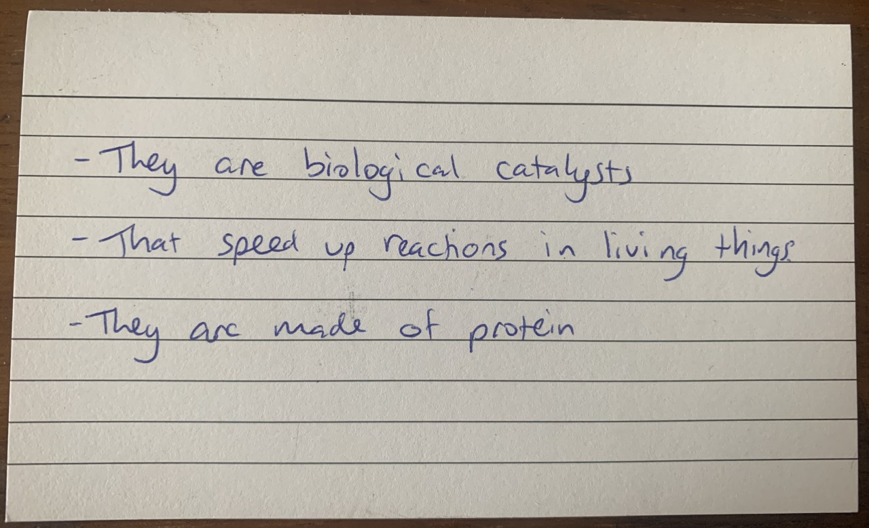
Flashcards

Slide 5
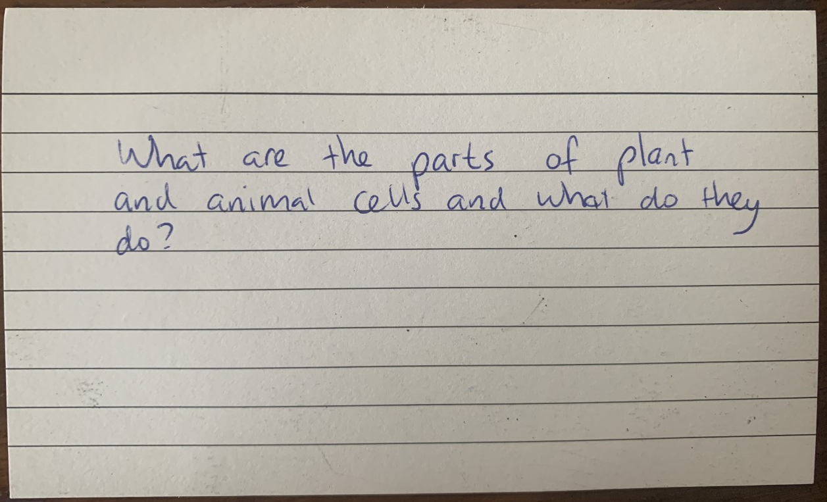
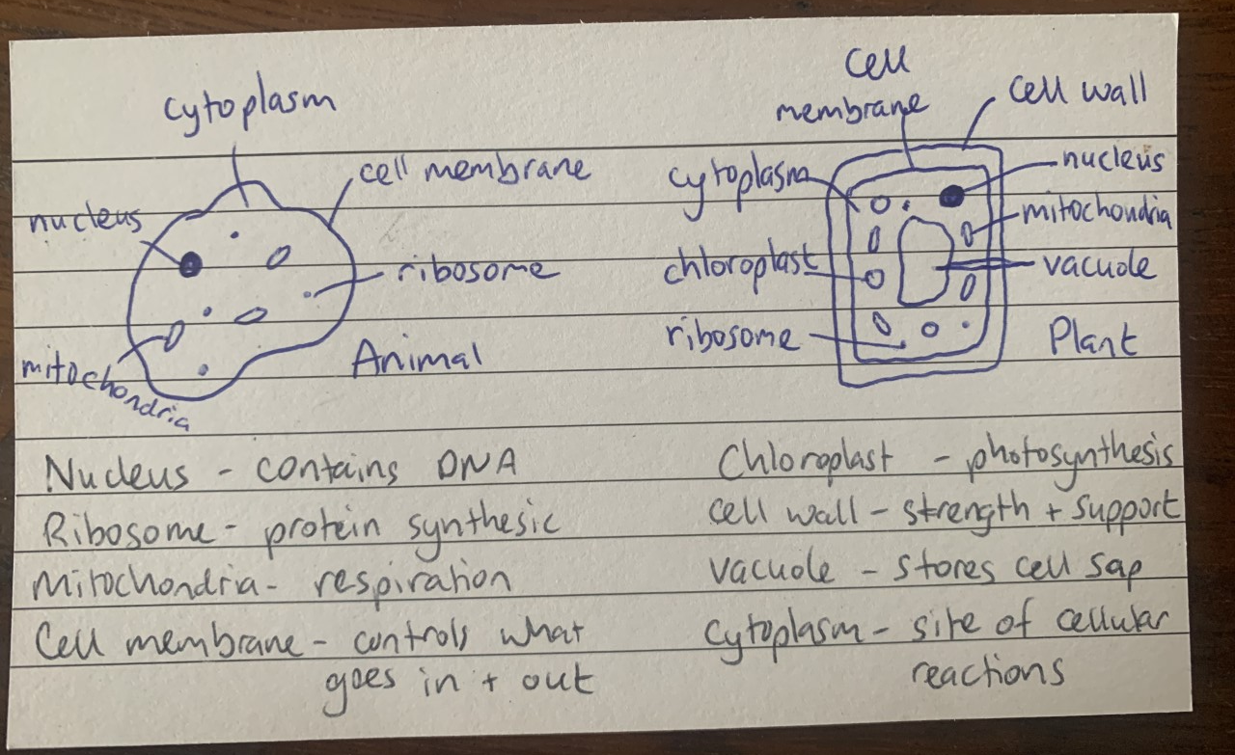
Flashcards

Slide 6
Useful websites
Seneca Learning – https://senecalearning.com/en-GB/
Cognito - https://cognitoedu.org/
BBC bitesize - https://www.bbc.co.uk/bitesize/examspecs/zqkww6f
Free Science Lessons - https://www.freesciencelessons.co.uk/
Or find the free science lessons channel on youtube

Slide 7
Past Papers
These can be accessed through the exam board website:
https://qualifications.pearson.com/en/qualifications/edexcel-gcses/sciences-2016.html

