Slide 1

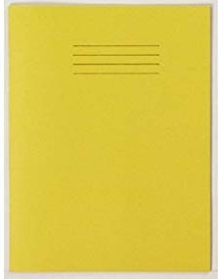




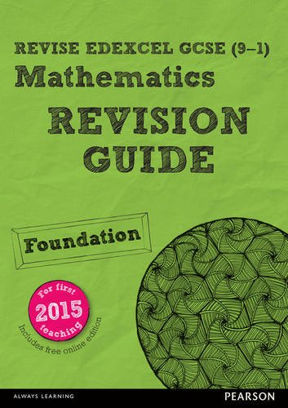
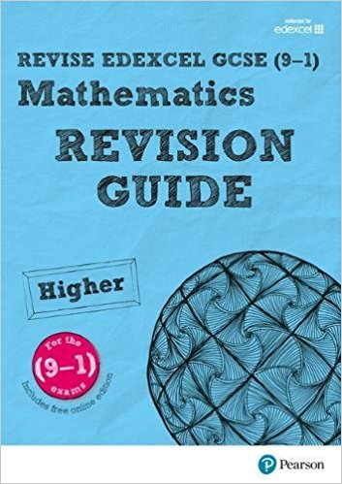



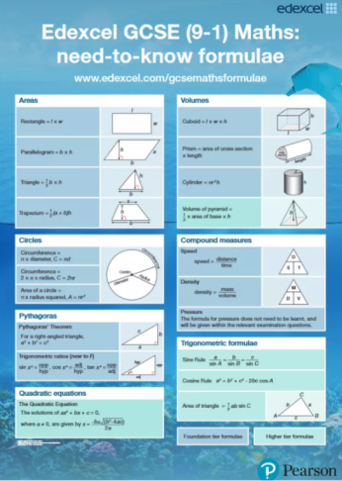
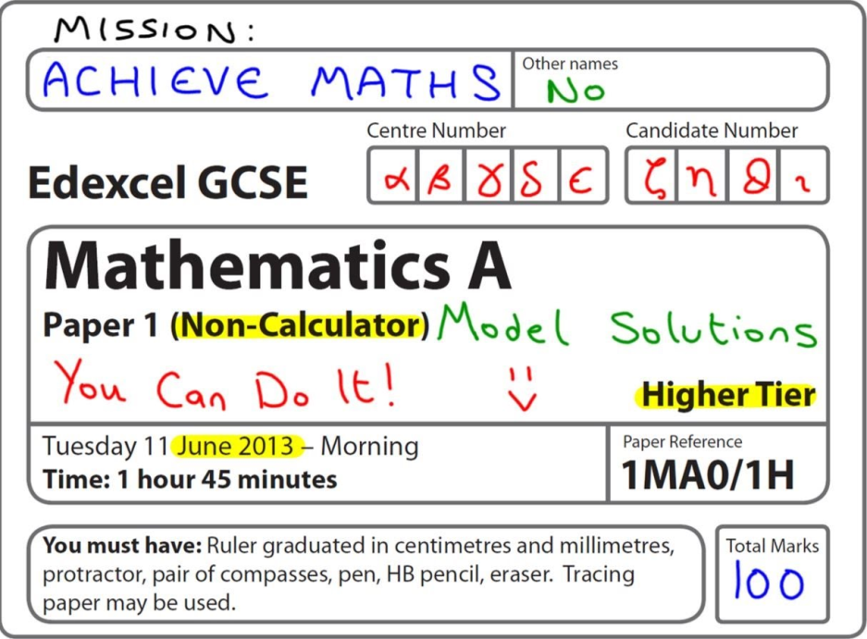
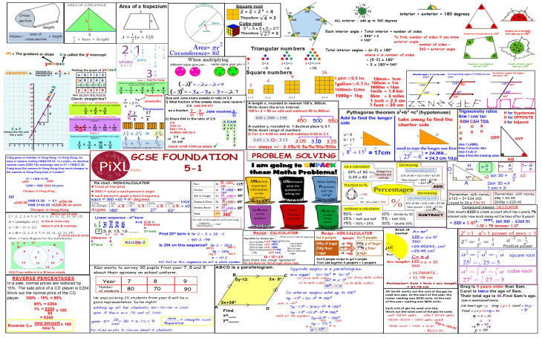
How do you revise for GCSE maths?
PERIOD 6

Slide 2
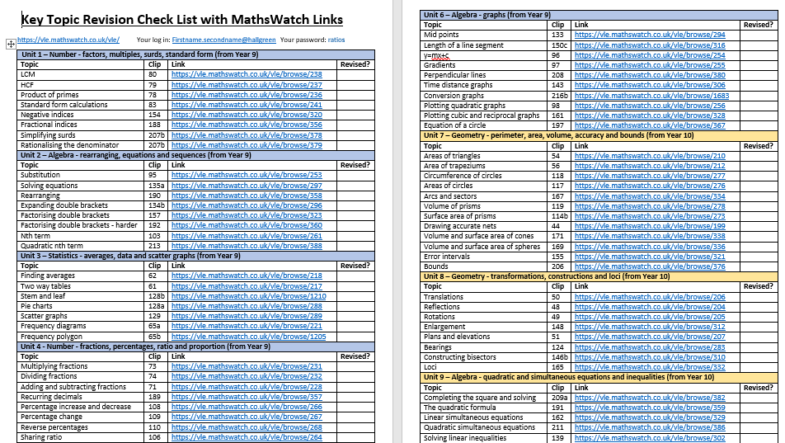
Check lists and RAG sheets
Use a check list of topics
Revise regularly
Keep your revision separate
Make mind maps with colour
Green – I know it, I don’t need to revise this at the moment
Orange – I need to revise this and improve my understanding
Red - I need to learn this again.
EXAM PRACTICE

Slide 3
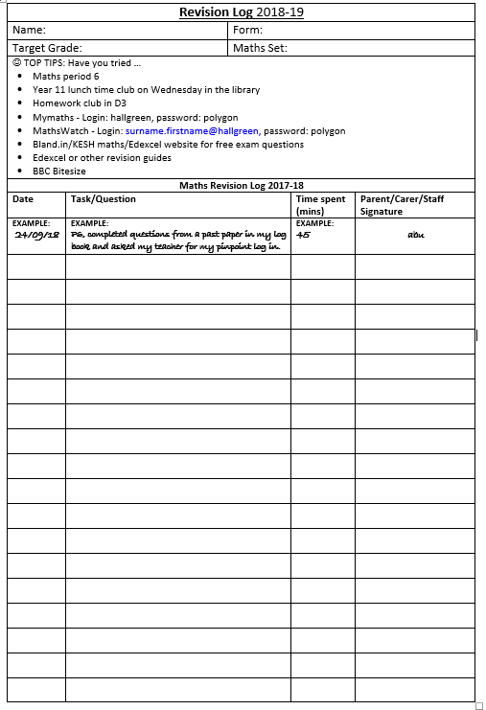
Log Books
Use a check list of topics
Two double pages, every week.
Write down the topic and the clip number
Revise regularly
Keep your revision separate
Make mind maps with colour
EXAM PRACTICE

Slide 4

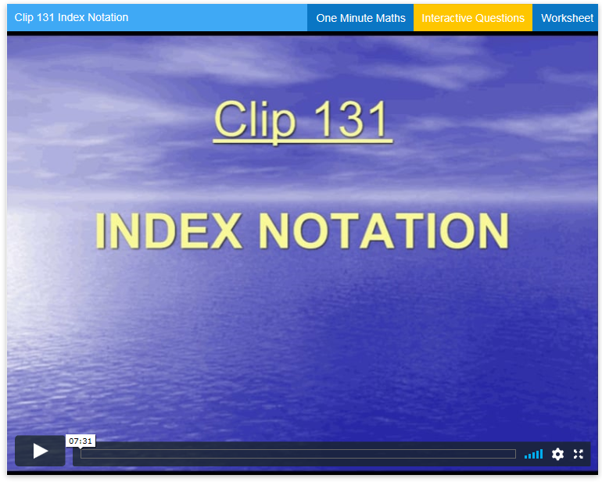
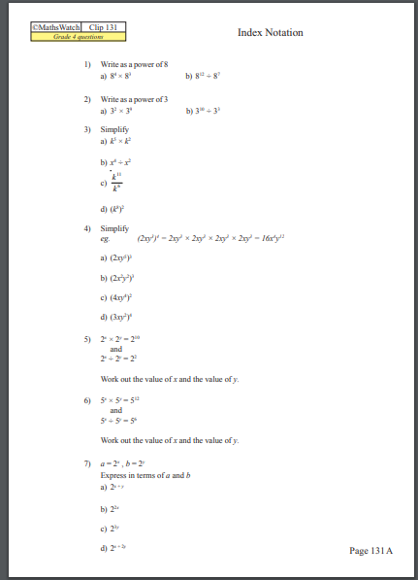
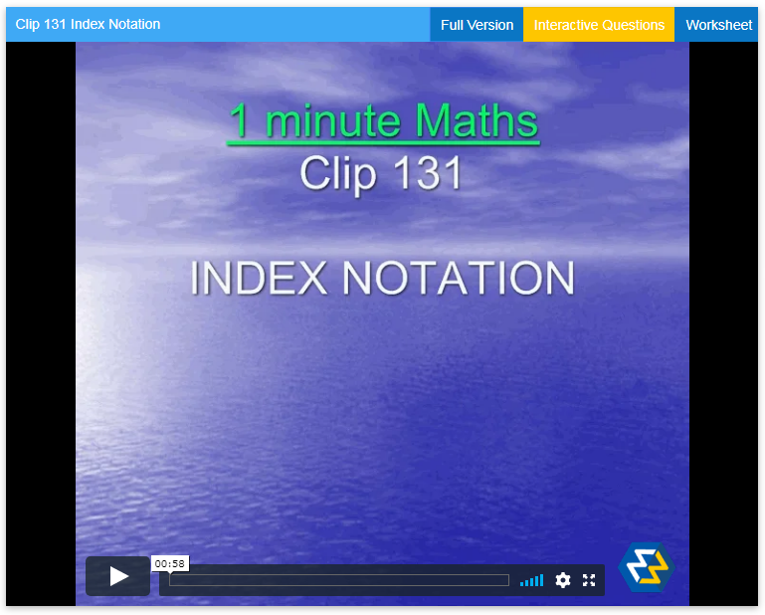
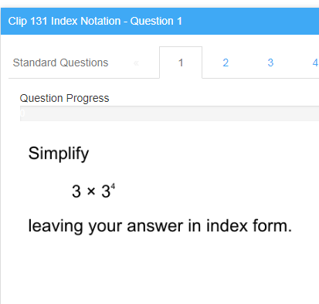
Use a check list of topics
Firstname.Surname@hallgreen
Revise regularly
Keep your revision separate
Make mind maps with colour
EXAM PRACTICE

Slide 5
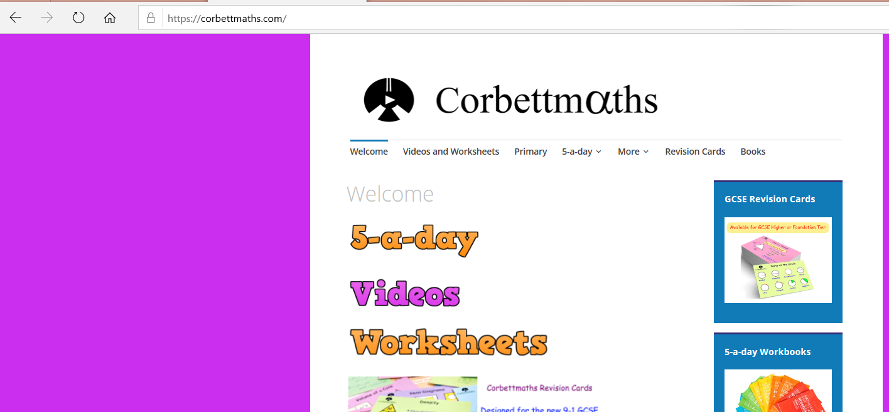
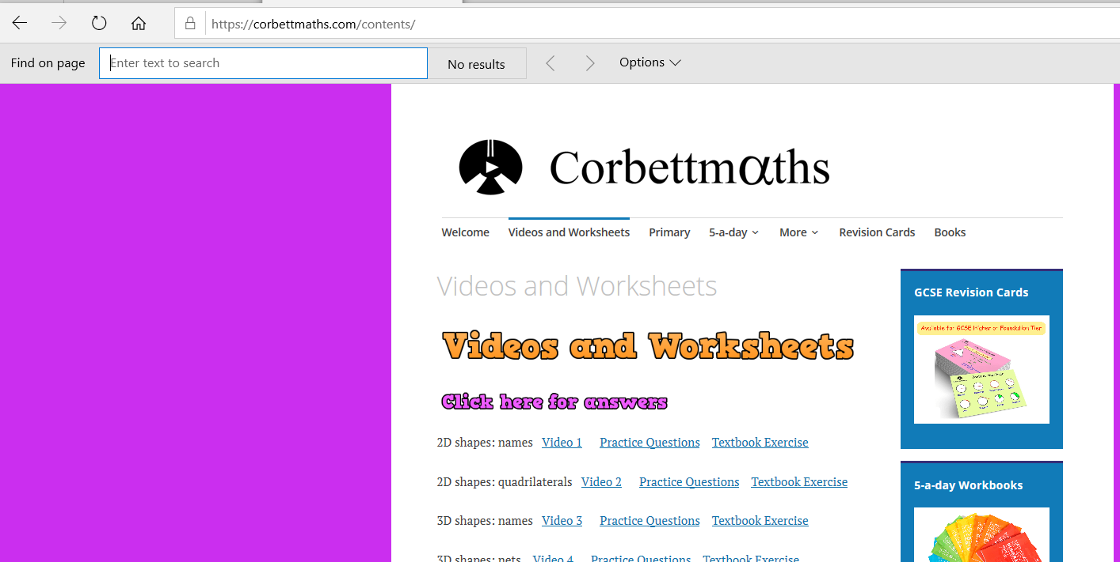
www.CorbettMaths.com
Use a check list of topics
This is a fantastic website to find practice questions on every topic
Revise regularly
Choose worksheets
Press Ctrl F, then search the page for any topic
Keep your revision separate
Make mind maps with colour
Watch a video first and make notes
Choose Textbook Exercise for plenty of practice questions with answers
EXAM PRACTICE
Choose Practice Questions for all types of exam questions on this topic

Slide 6
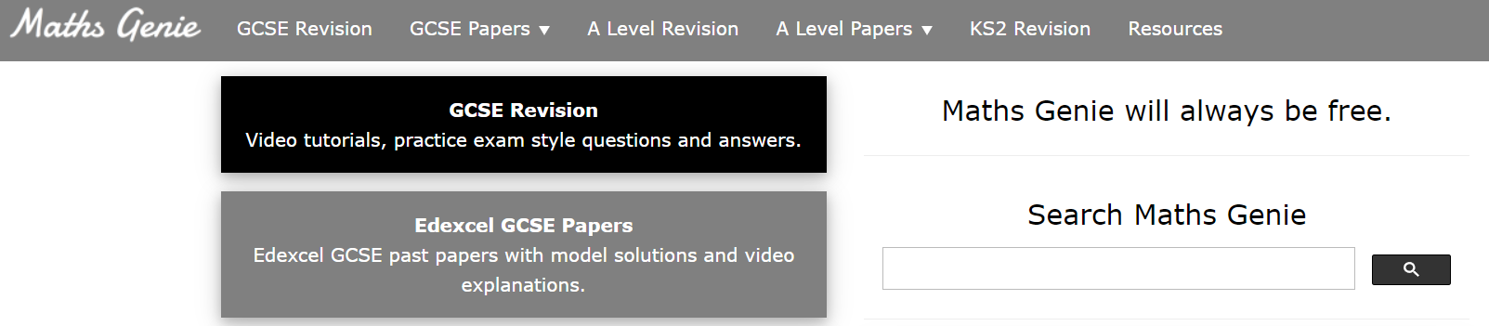
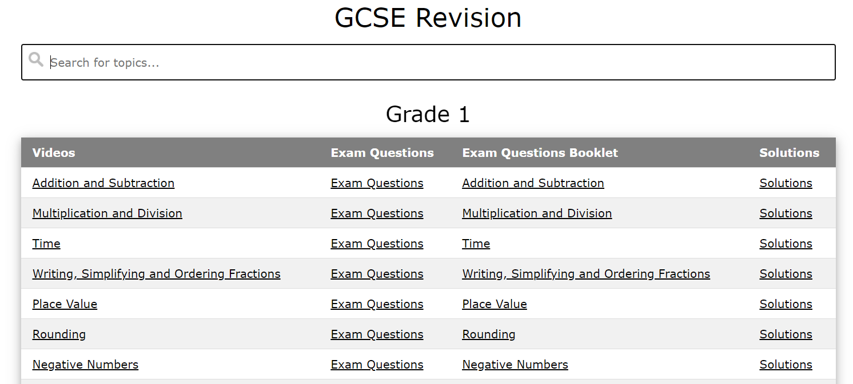
www.MathsGenie.co.uk
Use a check list of topics
This is a fantastic website to find practice questions on every topic
Revise regularly
For revision
For papers
Keep your revision separate
Search for a topic
Make mind maps with colour
Watch a clip
EXAM PRACTICE
Exam practice
Mark your work

Slide 7
Maths Club and Period 6
Use a check list of topics
Monday lunch times in Room 2 – collect a past paper
Friday lunch times in D3 – help with revision and homework
Period 6 sessions – ran after school by class teachers.
Revise regularly
Keep your revision separate
Make mind maps with colour
EXAM PRACTICE

Slide 8
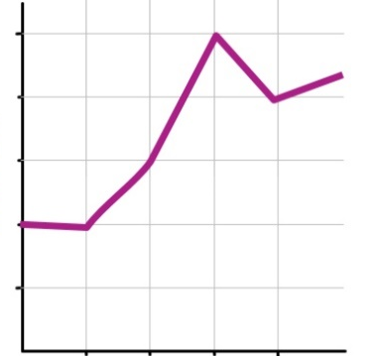
Fortnightly past papers
Use a check list of topics
Revise regularly
Keep your revision separate
Track your progress
Get plenty of exam practice
Identify what you need to revise next
Make mind maps with colour
EXAM PRACTICE

Slide 9
