Slide 1
Supporting KS4 Pupils at Home

Slide 2
What to expect
First exam – 9th May 2024
Last exam 19th June 2024
Contingency day – 26th June 2024
On average, a pupil will have between 20 and 25 exams, lasting between an hour and two and a quarter hours.
The timetable will be on the school website

Slide 3
Key dates before then:
20th September – StudySkillsZone
29th September – Who Am I
9th October – Y11 mock exams 1
10th November – Y11 mock results day 1
25th January – Y11 Reports
11th March – Y11 mock exam 2
19th April – Y11 mock results day 2

Slide 4
Key Performance Indicators
Attendance
Attitude to learning
Completing classwork and homework
Revision and independent study

Slide 5
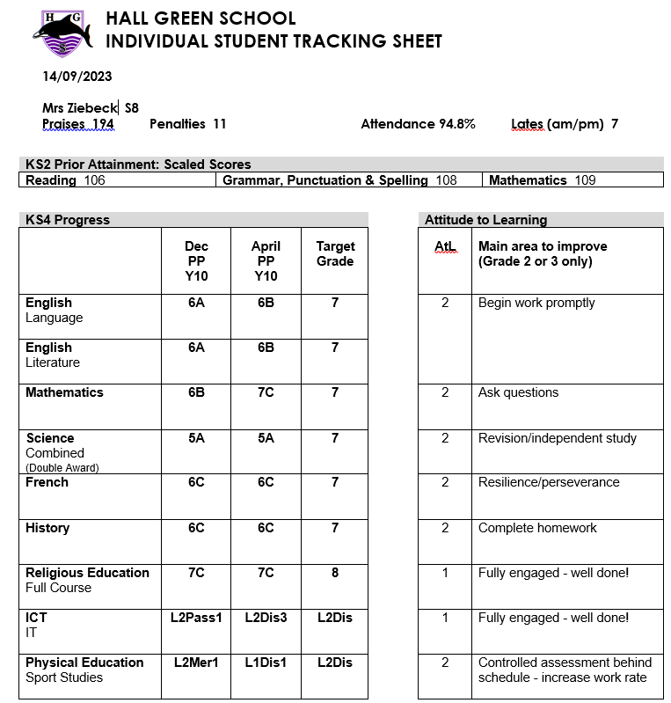

Slide 13
1 | Fully Engaged! | Has high standards and a clear desire to succeed Comes fully prepared to class, with the right books and equipment, on time and ready to learn Takes responsibility for own learning, asking questions when unsure Doesn’t give up in the face of difficulties, acts on feedback and tries not to repeat mistakes Works well in a team & promotes a good learning environment Takes pride in work and presents it to the best of their ability Completes all homework & gap tasks Catches up on missed work Works independently to prepare for assessments | Success and achieving targets Praise/reward
2 | Mostly Engaged | Achieves some of the above, but needs to achieve more to secure a 1 | Learning conversation (Form Tutor)
3 | Behavioural Issue | Disrupting the learning of others Disengaged from own learning | HoH involved
Notes:
Mr Adams introduced this – what you need to do and what we know leads to success – that’s why we introduced
If you keep getting 1s for AtL you’ll do the best you can….no one can ask for anymore

Slide 14
2. What can you do to support
Praise 5 times more than you nag!
Create a space in which pupils can revise
Give up bits of the house for revision walls
Negotiate over time stealers
‘Weigh’ revision folders
Keep them optimistic and set goals
Push when not working, take pressure off when signs of too much stress
Get them to talk about their work – ask ‘why’
Emphasise – they are going through a tough time!

Slide 15
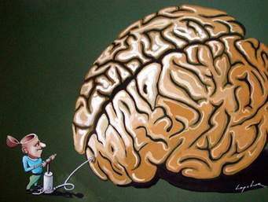
Notes:
We’re going to exercise our brains and make it bigger…. You are all going to get smarter and wiser over the next 6 months and you’re going to grow up and become young adults…

Slide 16
We’re designed to forget!
It’s been shown you need to revise something 5 times before you have learnt it
Every time you revise (properly), your brain gets bigger!
It is boring and stressful!
Pupils are in competition with every Yr 11 pupil in the country – they need to create your competitive advantage

Slide 17
The 45 minute revision session
Be in a quiet place with no distractions
Have the materials with you
Switch of time stealers (or give them to your parents
Be creative – use flash cards, colours, mind maps, songs, pictures…
Keep note taking brief
Start the session by trying to recall what you learnt in your previous session – compare and work out what you still don’t know
Now revise what you don’t know

Slide 18
Independent Study - Key messages
Reading is the least efficient way of revising
If you only look at something once you will forget it
You need to revise something 5 times to recall most of it
Revision should be interactive, using mind maps, mnemonics, flash cards, colour, tweets and song!
Revision sessions should be 45 minutes long with all time stealers switched off
Start early and build up good revision notes (Cornell note taking) so that you can save the final stages of revision for past paper practice
Make sure you cover the whole syllabus.

Slide 19
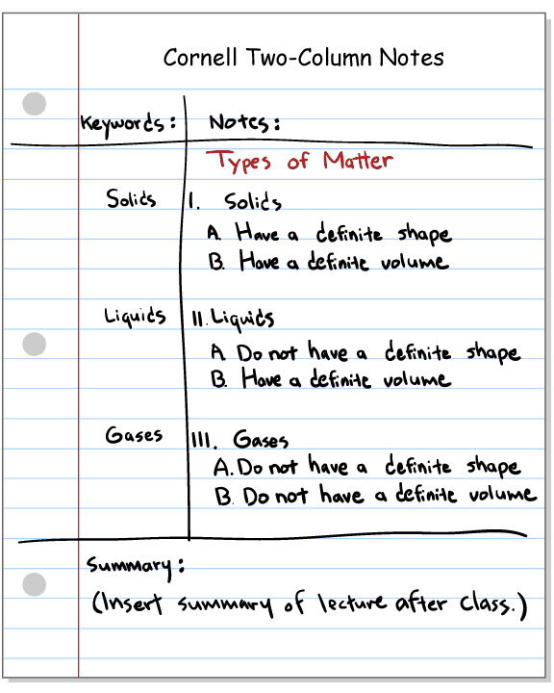
Cornell Note Taking Format
Notes:
Use things that we’ve looked at like the Cornell note taking style

Slide 20
Notes:
We will learn, our brain will get stronger and we will find out better ways of revising for us!
We can all get better - set targets and goals.

Slide 22
Websites that can help…
ClassCharts
GCSE Pod
Seneca
MathsWatch
Hodder Boost
Exam board websites
BBC Bitesize
Quizlet
Adapt
Oak Academy

Slide 23
Managing stress levels

Slide 25
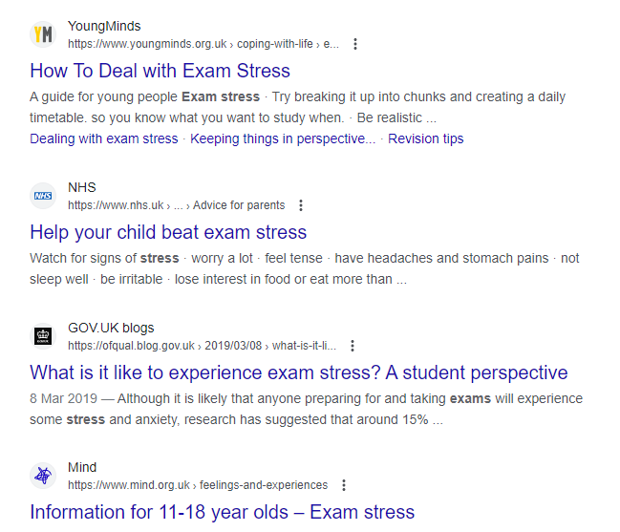

Slide 26
Have a discussion – what will be the new terms of use .....

Slide 27
Strategies to Reduce Phone Usage for 11-16 Year Olds

Slide 28
Strategy 1: Set Clear Boundaries
Establish specific hours for phone usage, such as after completing homework. Discuss consequences for not following the rules.

Slide 29
Strategy 2: Encourage Offline Hobbies
Support interests like painting, sports, or playing a musical instrument. Show how enjoyable offline activities can be.

Slide 30
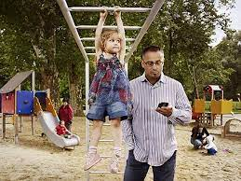
Strategy 3: Be a Role Model
Example: Limit your own screen time and prioritize face-to-face interactions. Children often mimic their parents' behaviours.

Slide 31
Strategy 4: Use Monitoring Apps
Family Link on android – monitor, block and time limits
Through your internet provider you can fix a time limit on internet usage
Example: Install parental control apps to track screen time. Discuss the importance of responsible phone use.

Slide 32
Strategy 5: Create Tech-Free Zones
Example: Designate bedrooms and meal times as tech-free zones. Promote family communication and bonding.

Slide 33
Strategy 6: Set Study Goals
Example: Help your child set achievable study goals. Reward them for reaching milestones without phone distractions.

Slide 34
When Strategies Don't Work
Despite your efforts, there may be challenges such as peer pressure or addiction. Seek professional help if needed e.g School Welfare team

Slide 35
Questions!

